Slide 1

Rice Grain Identification, Quality Classification And Counting System Using Raspberry Pi
Technological university (mandalay)
Department of Electronic Engineering
Presented by-
Mg Tin Htet Naing(VI EC-12)
Ma Shwe Thazin Tun(VI EC-40)
Supervised by-
Daw Su Mon Swe
Lecturer

Slide 2
Outlines
Abstract
Introduction
Aim and Objectives
Literature Review
System Block Diagram
Scope of Thesis
Software & Hardware Requirement
Implementation Procedure
Expected Outcomes
Conclusion
References

Slide 3
Abstract
The use of machine vision system for the grain classification.
Classifies according to the grain shape, color etc.
RGB color model, Morphological processing, edge detection are used to differentiate and analyzed the rice grains.
This thesis, discuss and suggest methods classify four varieties of rice using the image processing techniques.

Slide 4
Introduction
This thesis introduces how to filter and classify four types of rice in a grain mixture.
Machine vision systems are used to identify the quality of the grain. Digital images and videos are the key sources of the machine vision systems.
This thesis expects to collect data in Real_time, process and return the classified information.

Slide 5
Aim
To design, construct and develop Rice Grain Identification,
Quality Classification and Counting System to help people with
the use of image processing technique.
Objectives
To use image processing techniques and classification algorithms.
To implement the theories with microcomputer.
To set up Raspberry Pi microcomputer and Interfacing Pi Camera to it.
To process the input data on Raspberry Pi, giving the human helpful output and displaying it on screen.

Slide 6
Scope of Thesis
The scope of thesis area is as follows.
Studying image processing theories.
Using classification algorithms.
Implementing the process with Python programming language.
Applying the DIP techniques in real world applications.

Slide 7
Hardware Block Diagram
Processor
Grain Sample
Pi Camera
LCD Display

Slide 8
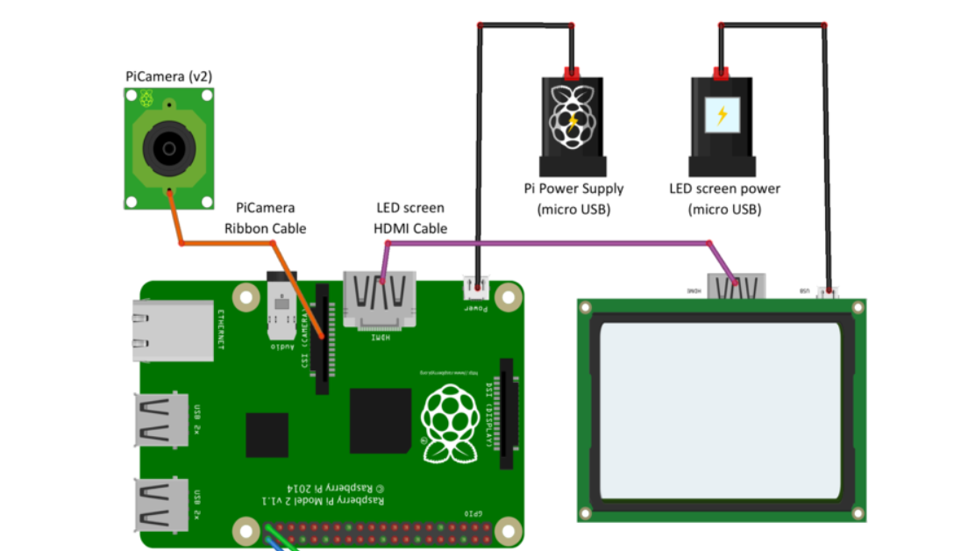
Circuit Diagram

Slide 9
Software Block Diagram
Grain Sample
Color-based
Segmentation
Pi Camera
Preprocessing
Classification
Shape-based
Segmentation
Display

Slide 10
Implementation Procedures
Rice grain samples are placed on black background.
Captured by a color Digital Raspberry Pi Camera.
Real-time video is captured and each frame is extracted and performed processing.
Different parameters of rice were extracted from the frames for further analysis.

Slide 11
RASPBERRY PI SETUP AND OPENCV INSTALLATION

Slide 12
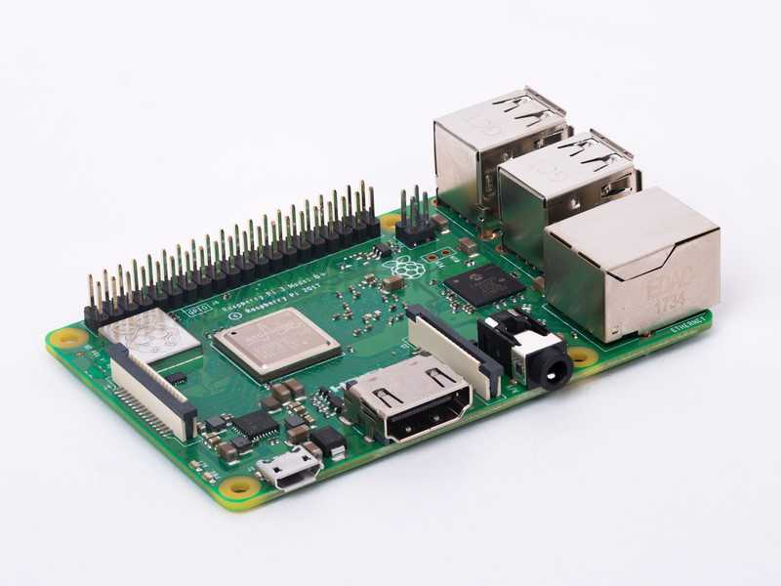
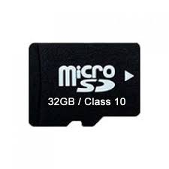
Boot Option
Boot from SD Card
Boot from USB
Raspberry Pi 3 B+
32 GB / Class10 micro SD

Slide 13
Operating System for Raspberry Pi
RASPBIAN
Debian-based computer OS for Raspberry Pi.
Version
Raspbian Wheezy [Python 2.7 (default), 3.2]
Raspbian Jessie [Python 2.7 (default), 3.4]
Raspbian Stretch [Python 2.7 (default), 3.5]
Raspbian Buster [Python 3.7 (default), 2.7]

Slide 14
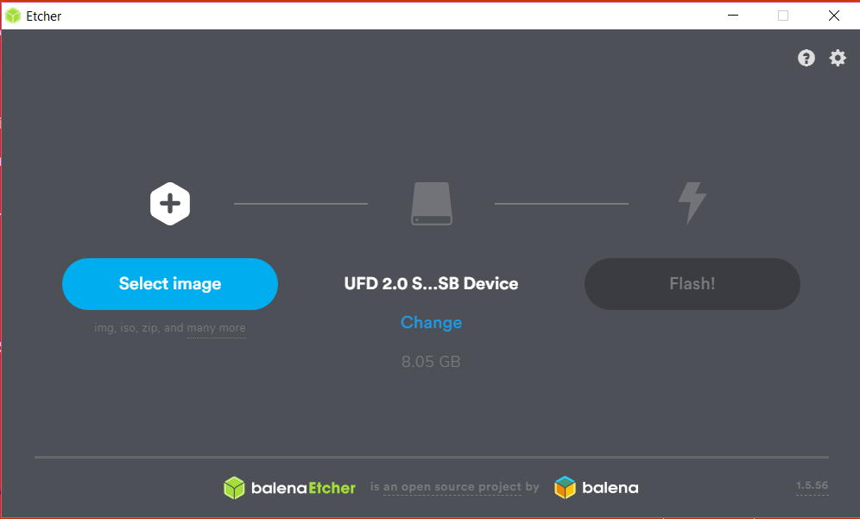
SD Card Writer
LINUX
sudo dd bs=1MB if=~/Download/raspbiran.img of=/dev/sdb
WINDOW
Etcher Software

Slide 15
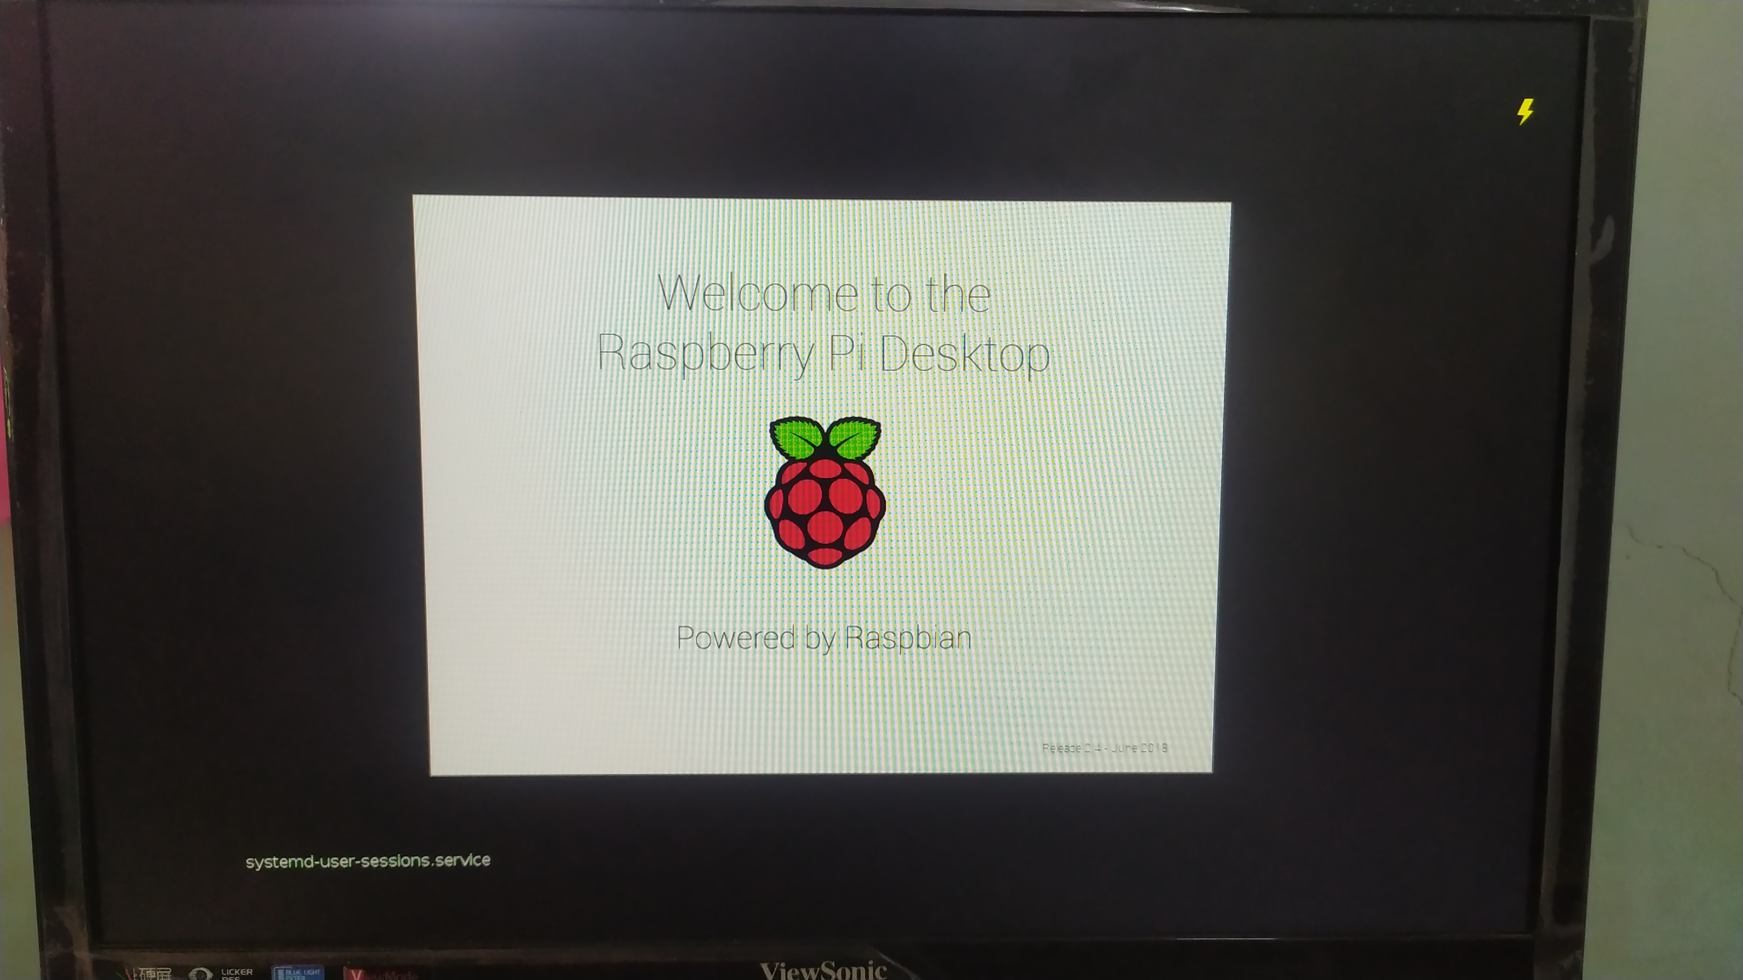
Raspberry Pi first boot

Slide 16
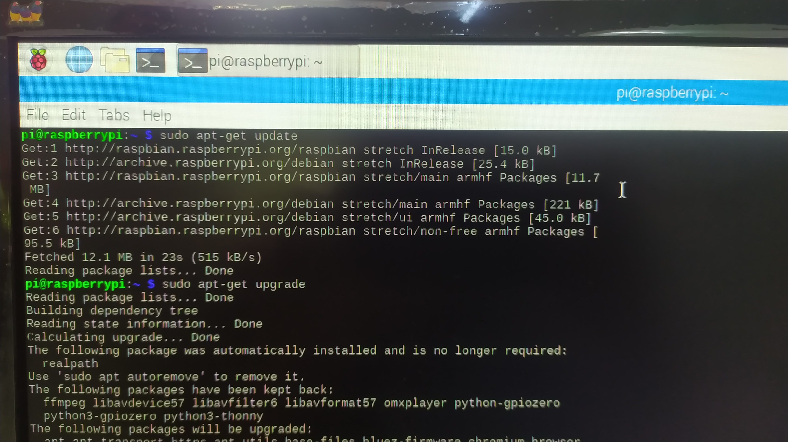
sudo apt-get update
sudo apt-get upgrade

Slide 17
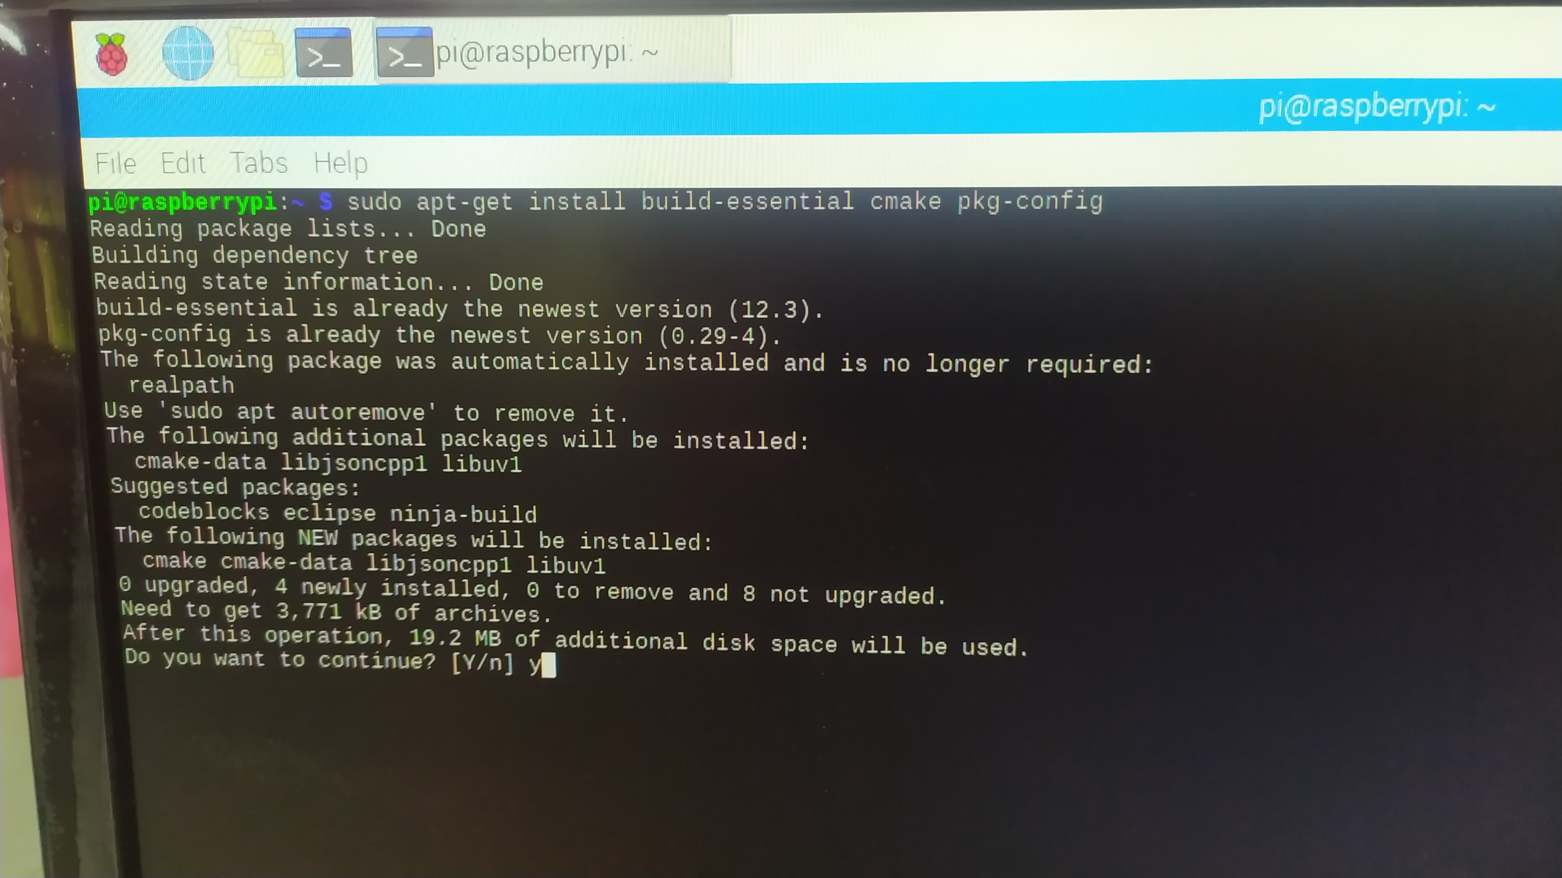
sudo apt-get install build-essential cmake pkg-config

Slide 18
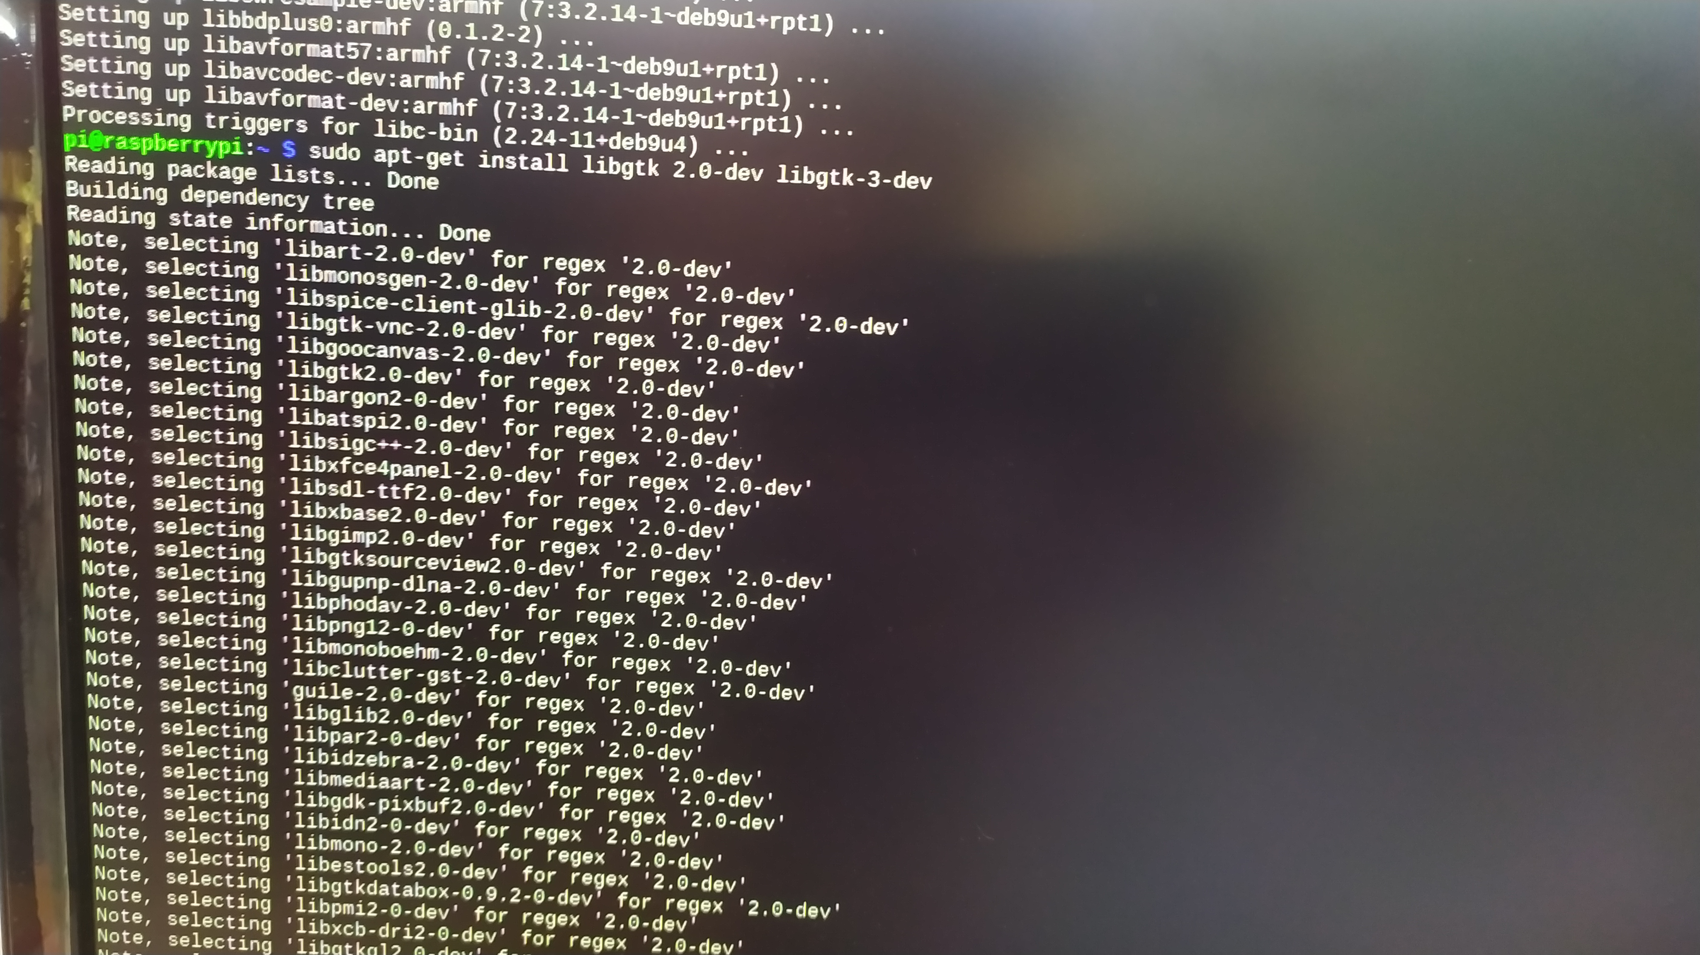
sudo apt-get install libjpeg-dev libtiff5-dev libjasper-dev libpng12-dev
sudo apt-get install libavcodec-dev libavformat-dev libswscale-dev libv4l-dev
sudo apt-get install libgtk2.0-dev libgtk-3-dev

Slide 19
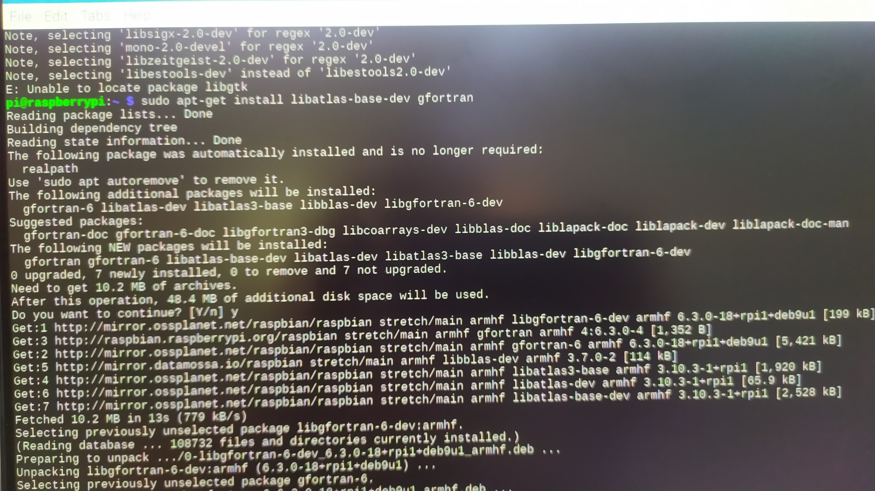
sudo apt-get install libatlas-base-dev gfortran
sudo apt-get install libqtgui4
sudo apt-get install libqt4-test

Slide 20
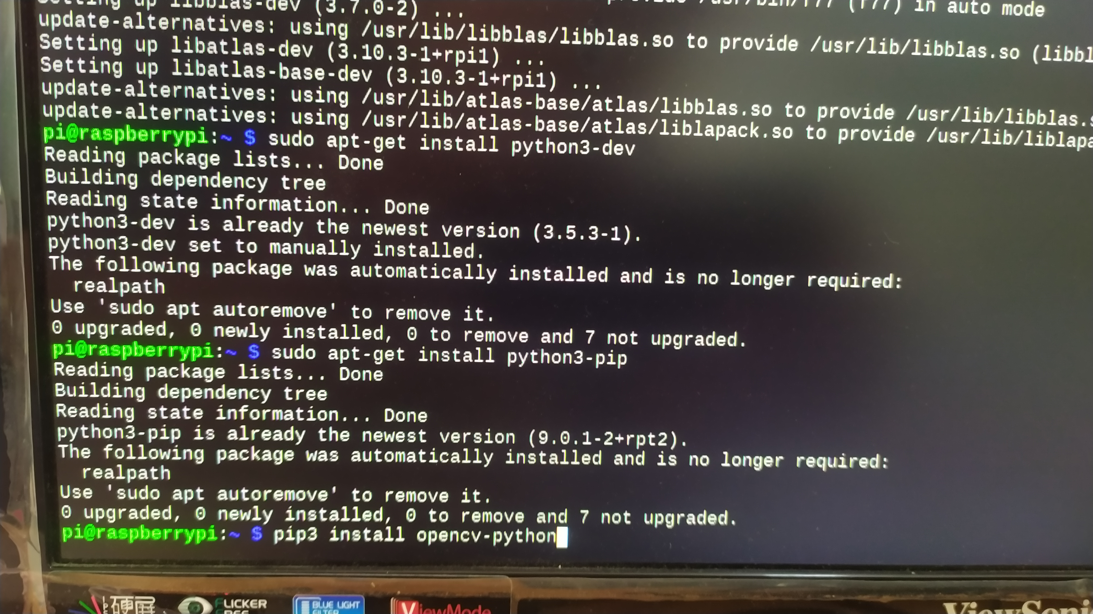
sudo apt-get install python3-dev
sudo apt-get install python3-pip

Slide 21
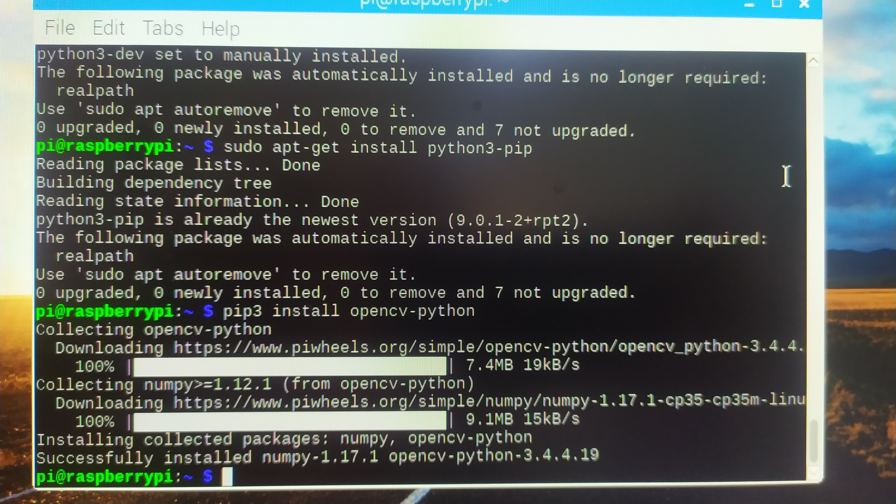
pip3 install opencv-python

Slide 22
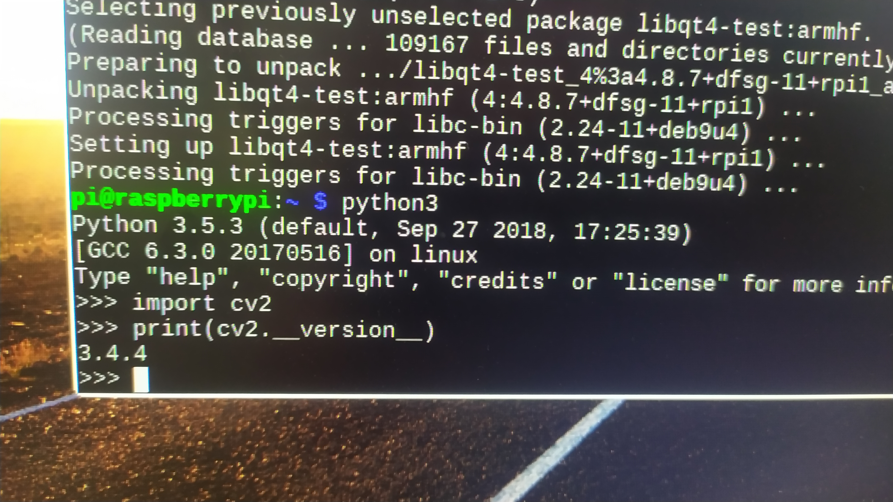
OpenCV3 was successfully installed on python3 Python version - 3.5.3 OpenCV version - 3.4.4

Slide 23
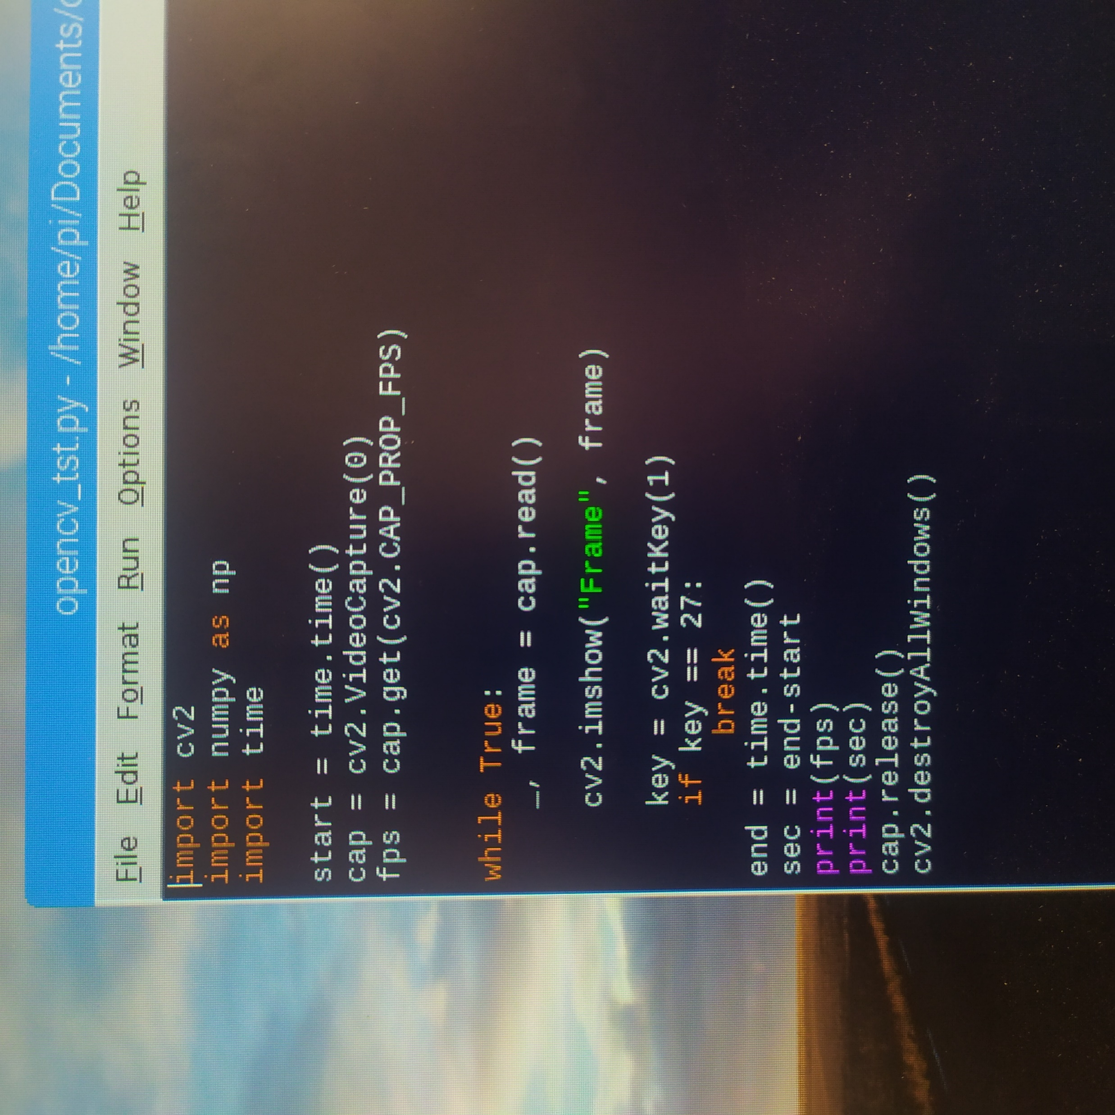
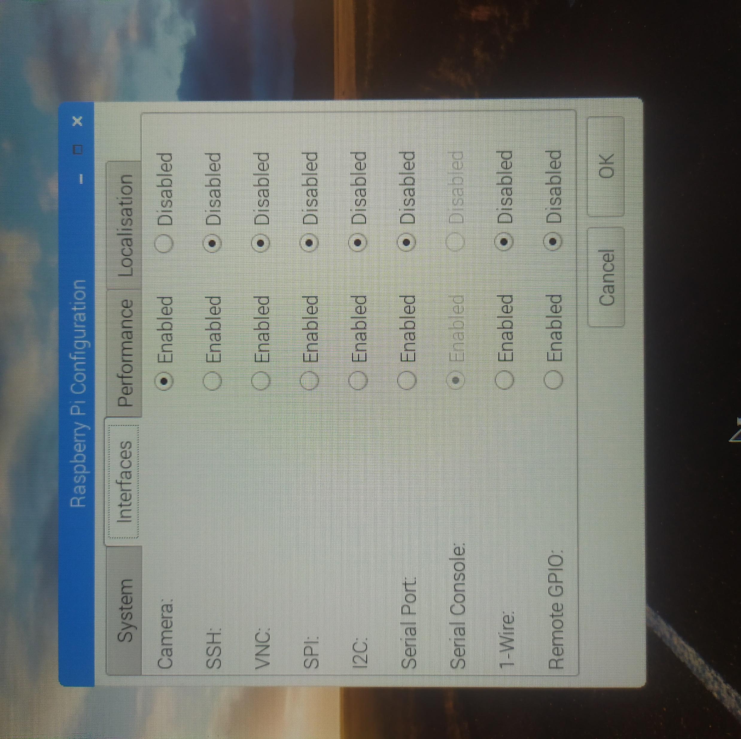
Camera Interfacing
Menu >> Preferences >> Raspberry Pi Configuration >> Interfaces >>
Camera : Enable
*Reboot
Cmd Prompt >> sudo modprobe bcm2835-v4l2

Slide 24
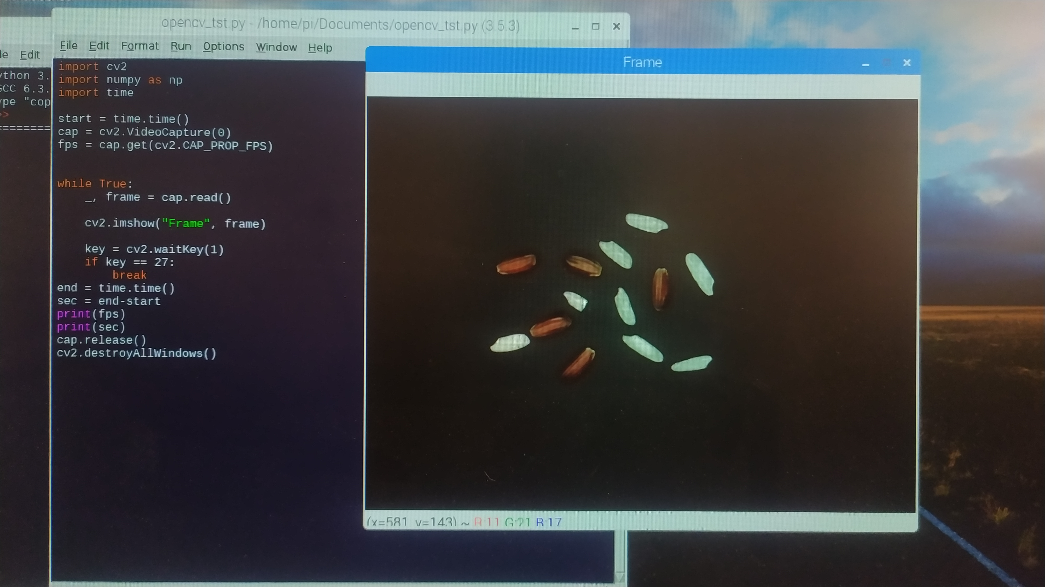
Result of captured image using openCV

Slide 25
SYSTEM IMPLEMENTATION AND RESULT

Slide 26
Identification
Red Grain
White Grain

Slide 27
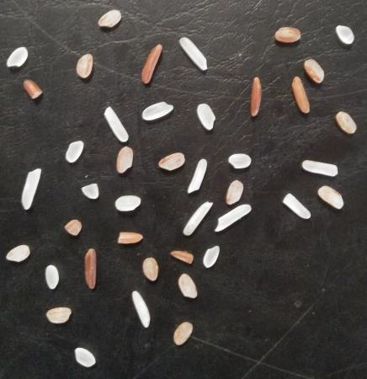
Grain Mixture

Slide 28
Identification using Color Plane
Red Grain
85 < R < 160
34 < G < 144
15 < B < 126
White Grain
123 < R < 184
127 < G < 189
128 < B < 190

Slide 29
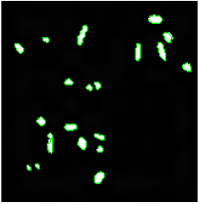
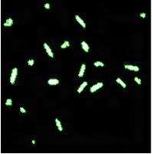
Expected Outcome for Identification
Red Grain
White Grain

Slide 30
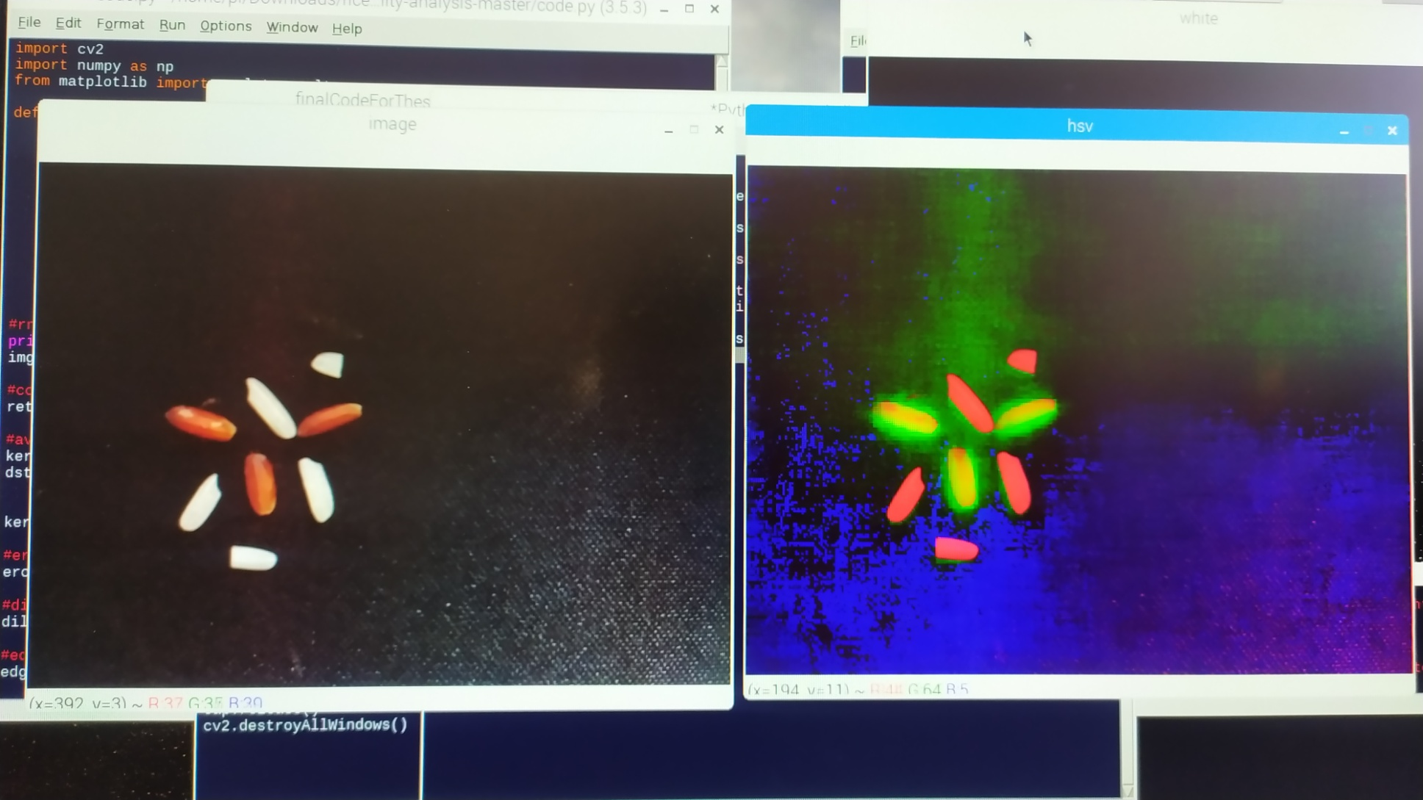
HSV Color Plane

Slide 31
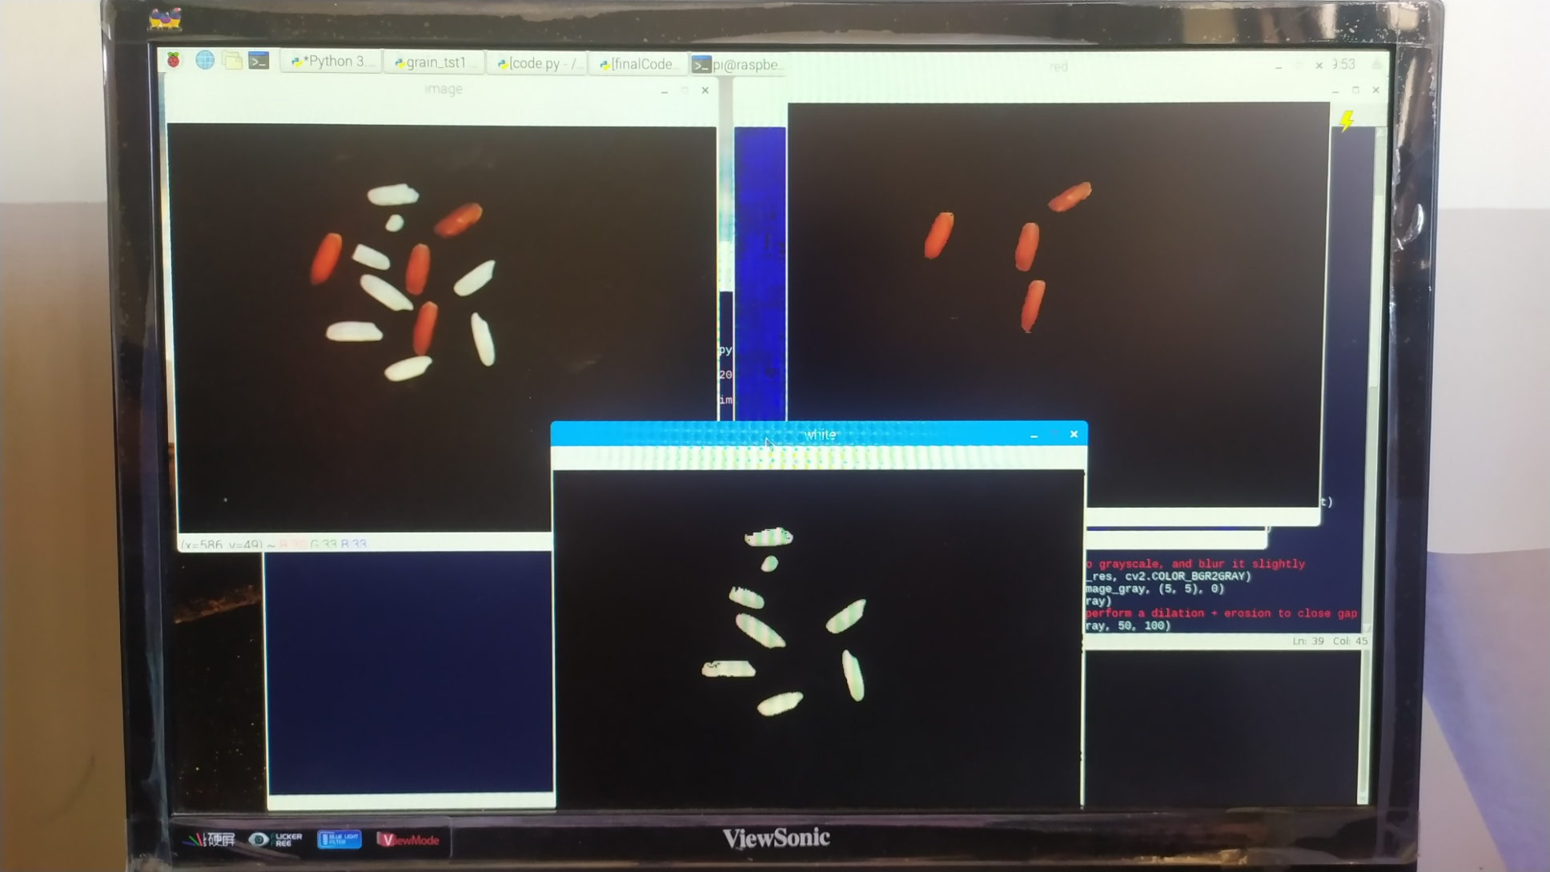
Identification Result

Slide 32
System Flow Chart
Start
A
Input RGB
image
Contour Detection
Convert GRB to HSV
Rectangular Bounding
Filtered by ROI
Ratio Calculate & Count
Preprocess
End
A

Slide 33
Preprocessing
Enhancement
The basic goal of image enhancement –
To process the image to assess the visual information.
For greater clarity.
Therefore, Image enhancement is rather subjective because it depends strongly on the specific information the user is hoping to extract from the image.

Slide 34
Processing Flow Chat for Image Enhancement
Start
A
Input RGB
image
Remove Noise
Convert GRB to Binary
Reconstruct image
Clear border
End
A

Slide 35
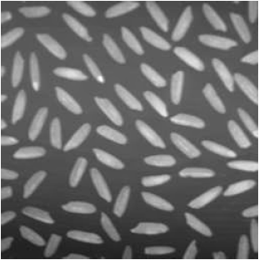
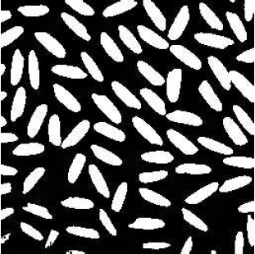
Expected Outcome for Enhancement
Before Image Enhancement
After Image Enhancement

Slide 36
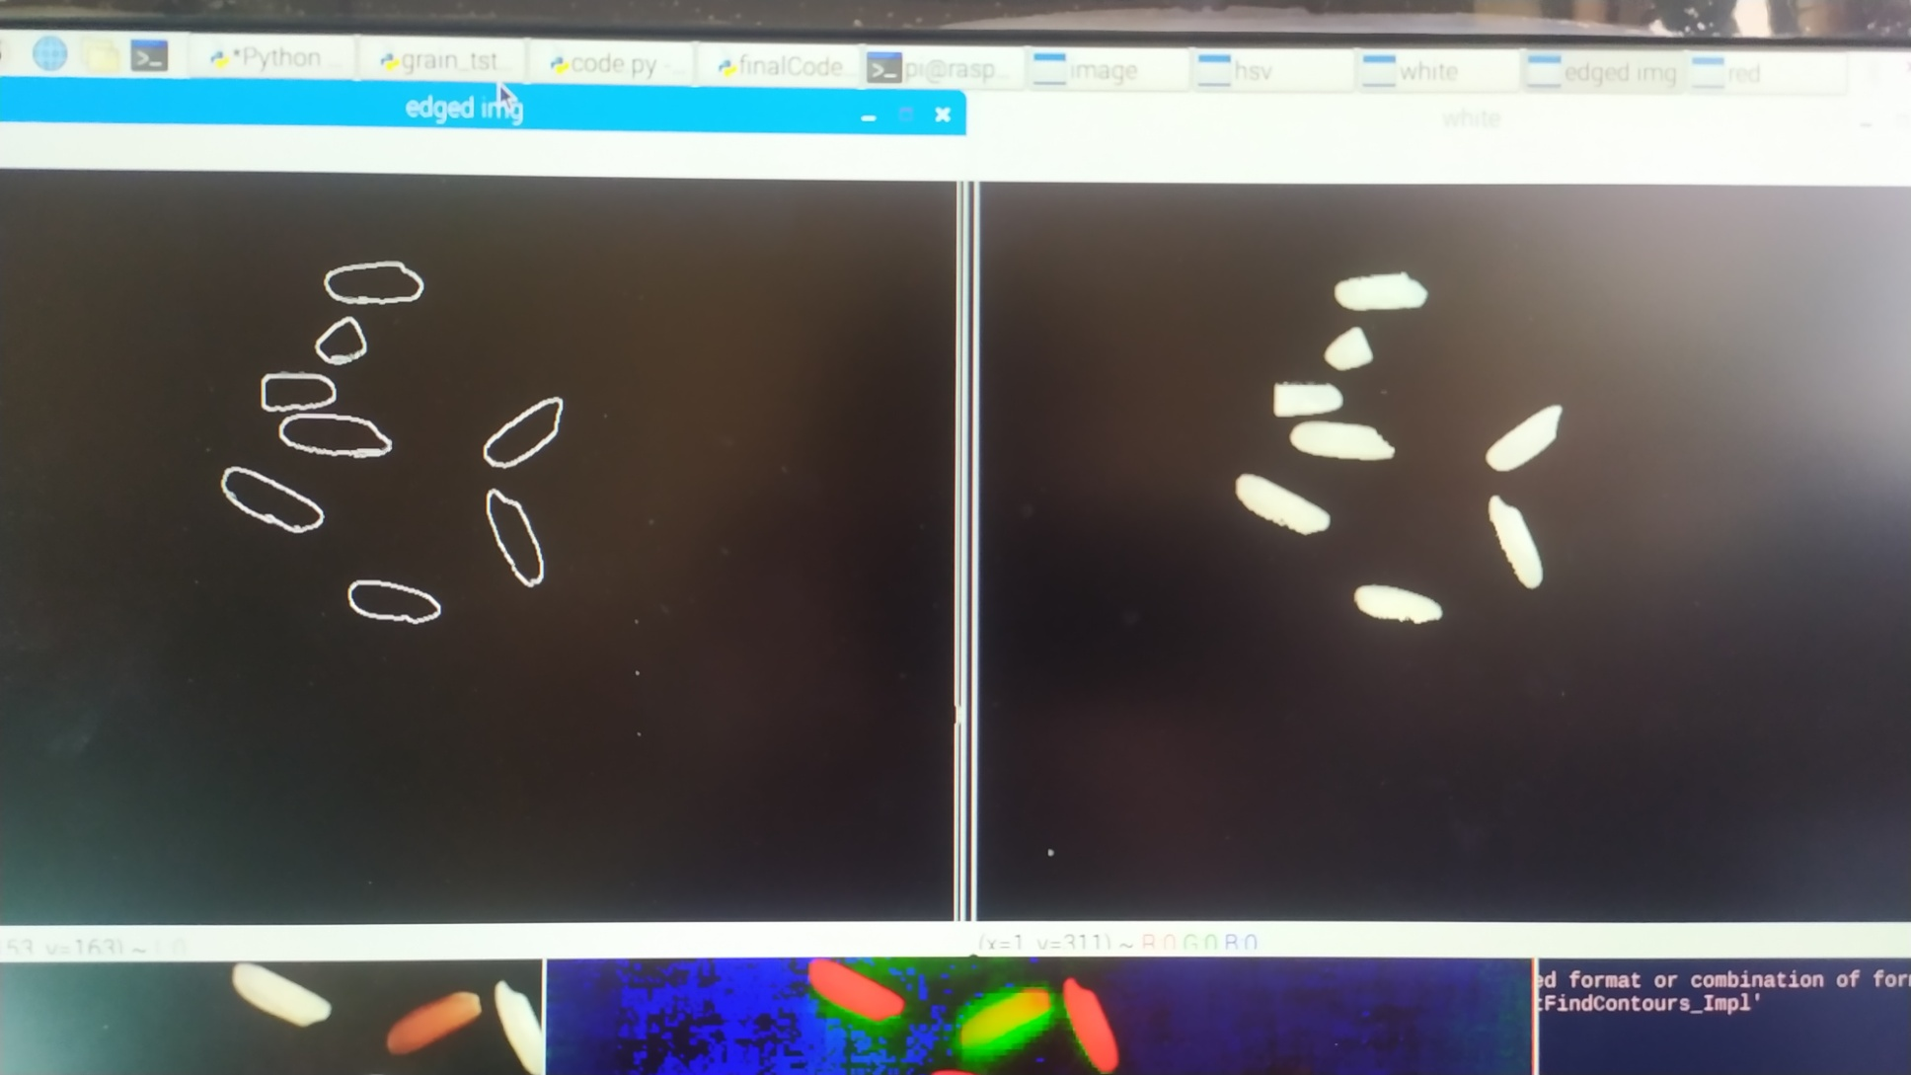
Result after preprocessing

Slide 37
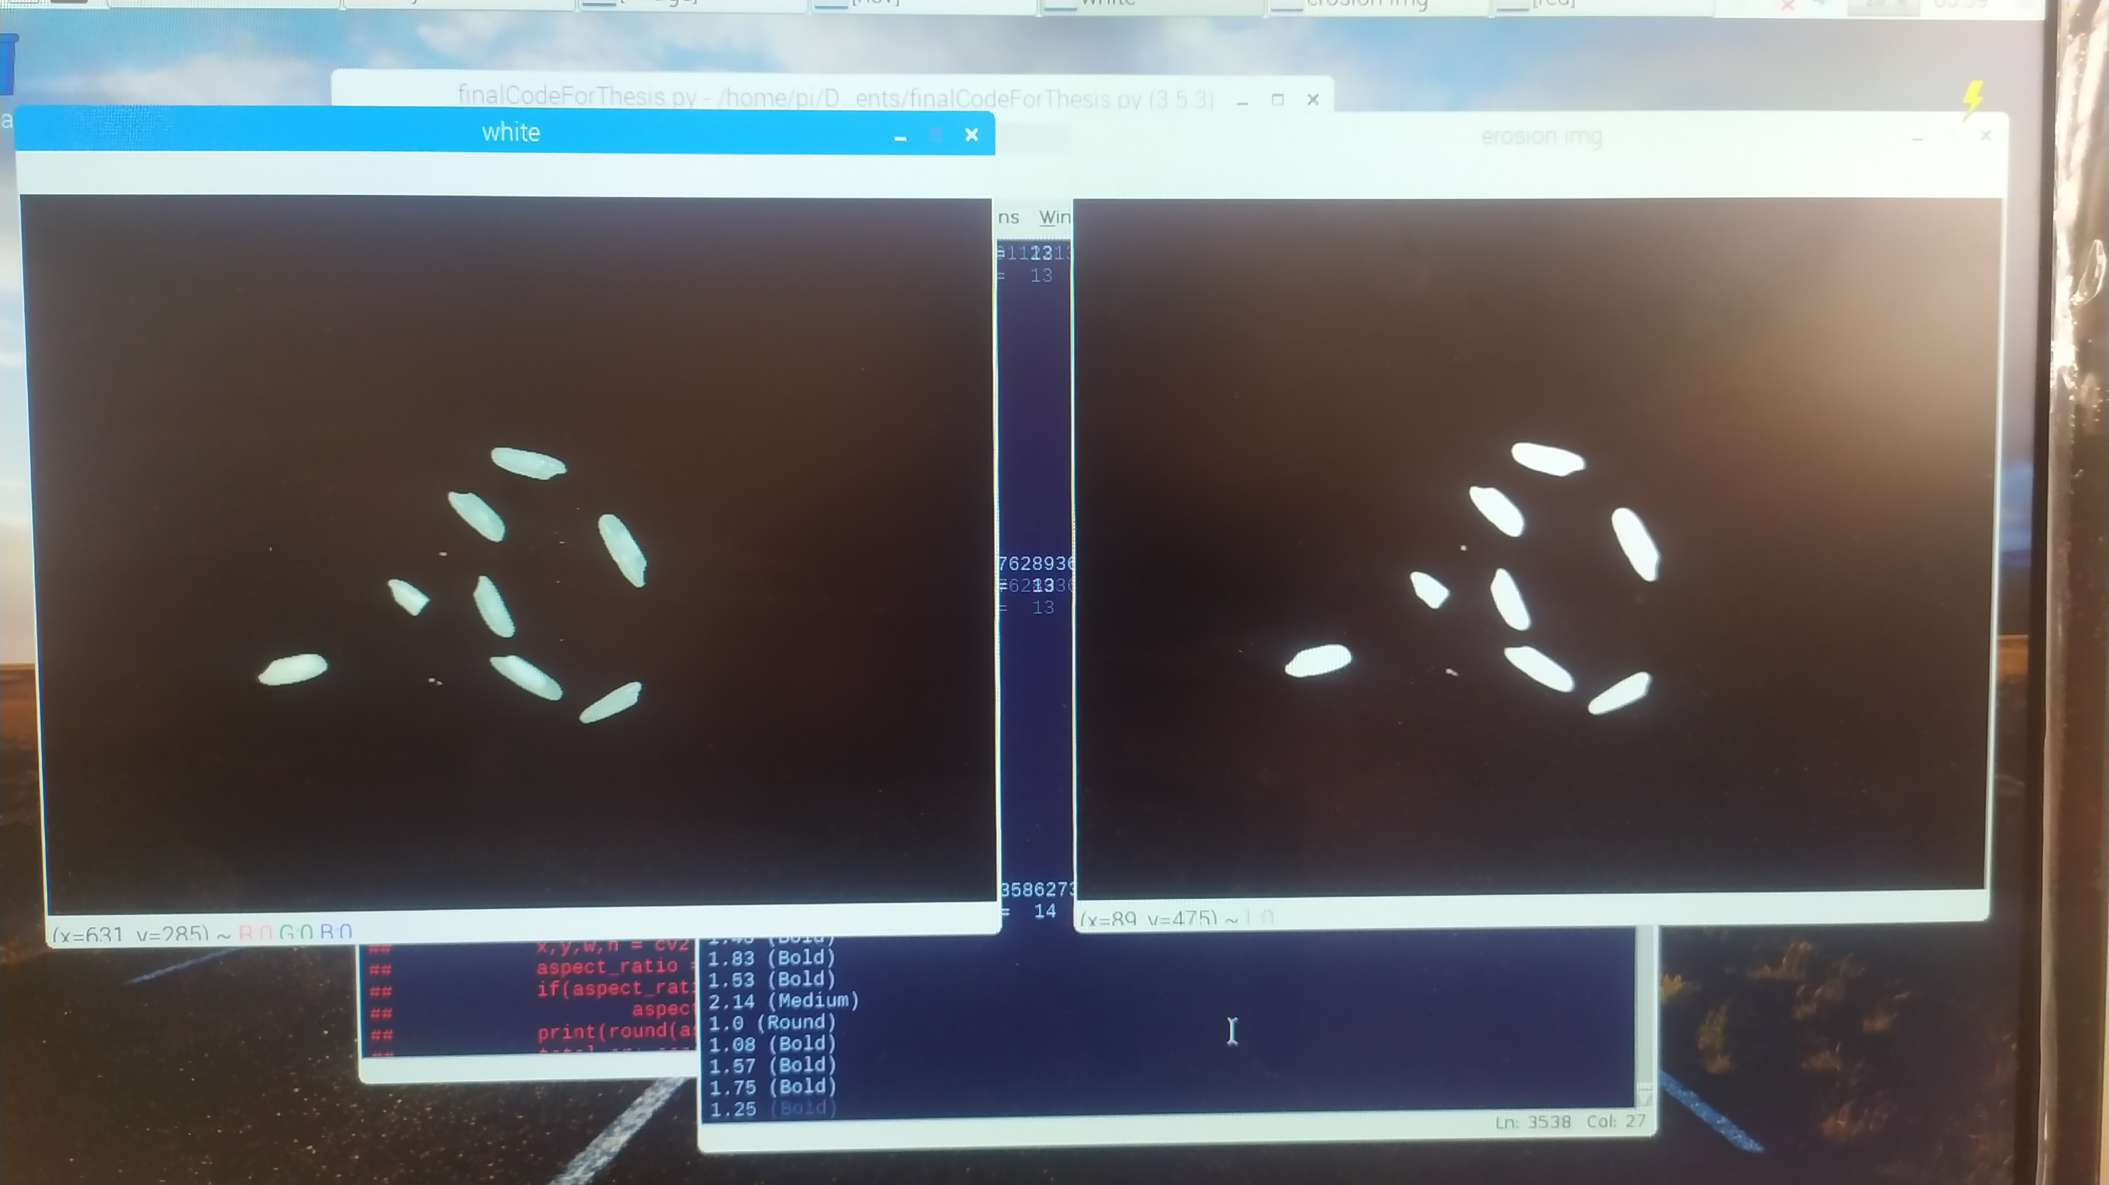
White Grain before and after preprocessing

Slide 38
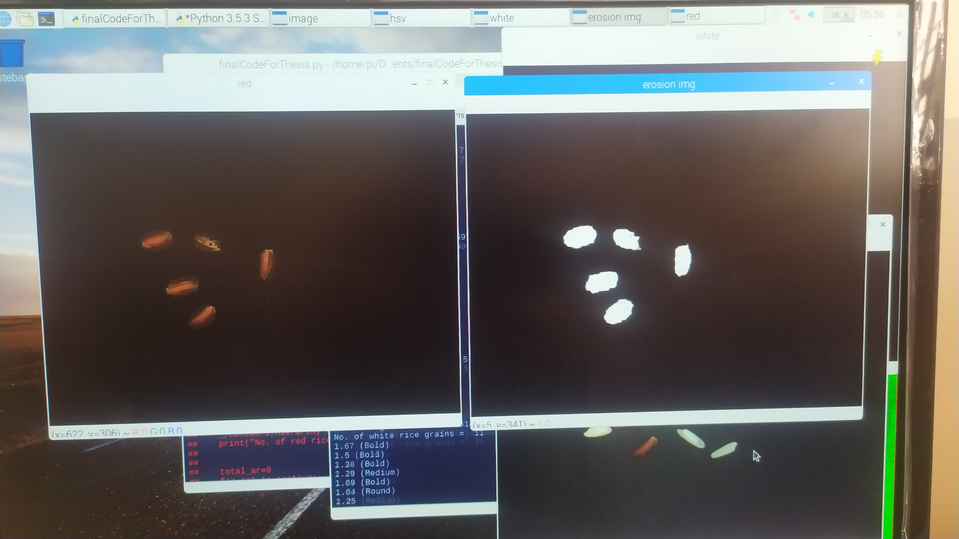
Red Grain before and after preprocessing

Slide 39
Quality Classification
Classified by Width-Height Ratio Calculation
Slender ( equal or above 3 )
Medium ( between 2 and 3 )
Bold ( between 1 and 2 )
Round ( equal or below 1 )

Slide 40
Method for Width-Height Ratio Calculation
Contours
Object bounding
x,y coordinate
Width
Height
Decision and output

Slide 41
Counting Rice
Area Estimation
Border Following
Horizontal Layered Scanning (HLS)

Slide 42

Border Following
The intention is to define the border and starting pixel of each rice grain, then follow each border around to the starting point, thus circling the rice grain and marking it as counted before moving on to the next.

Slide 43
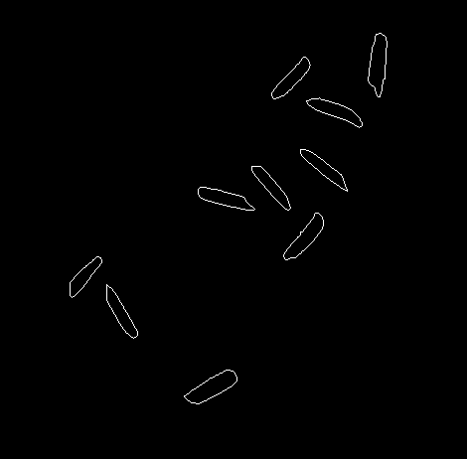
2
1
3
4
6
5
7
8
9
10
Pros:
Very accurate and easy to filter “false” rice
Cons:
Difficult to differentiate rice in close proximity.

Slide 44
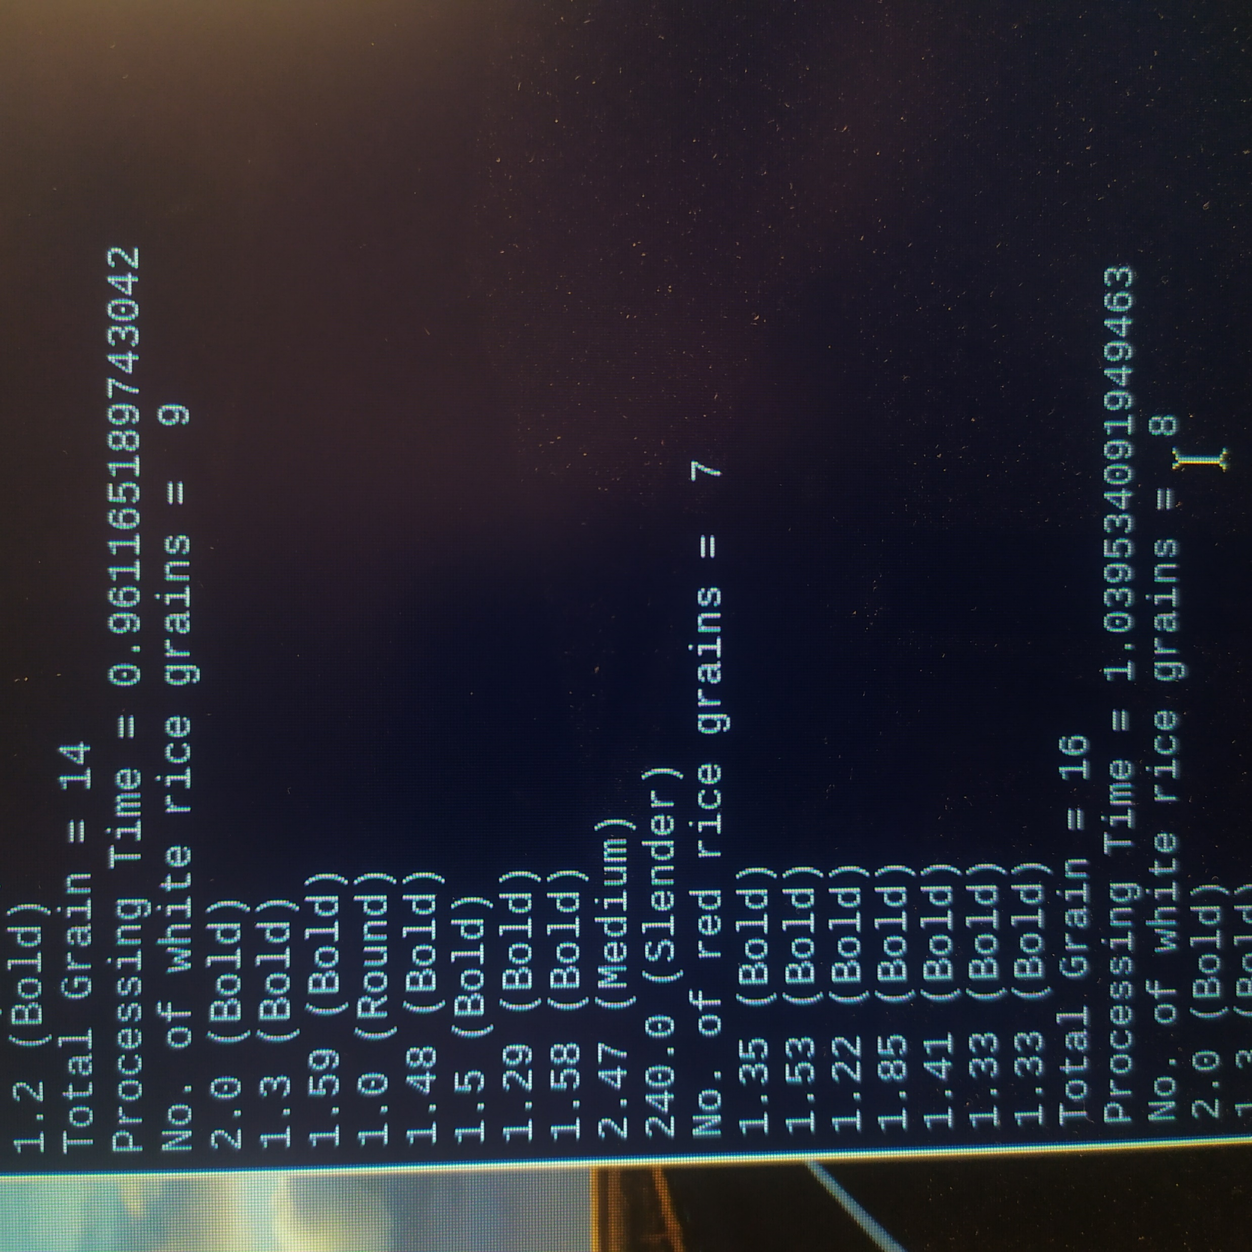
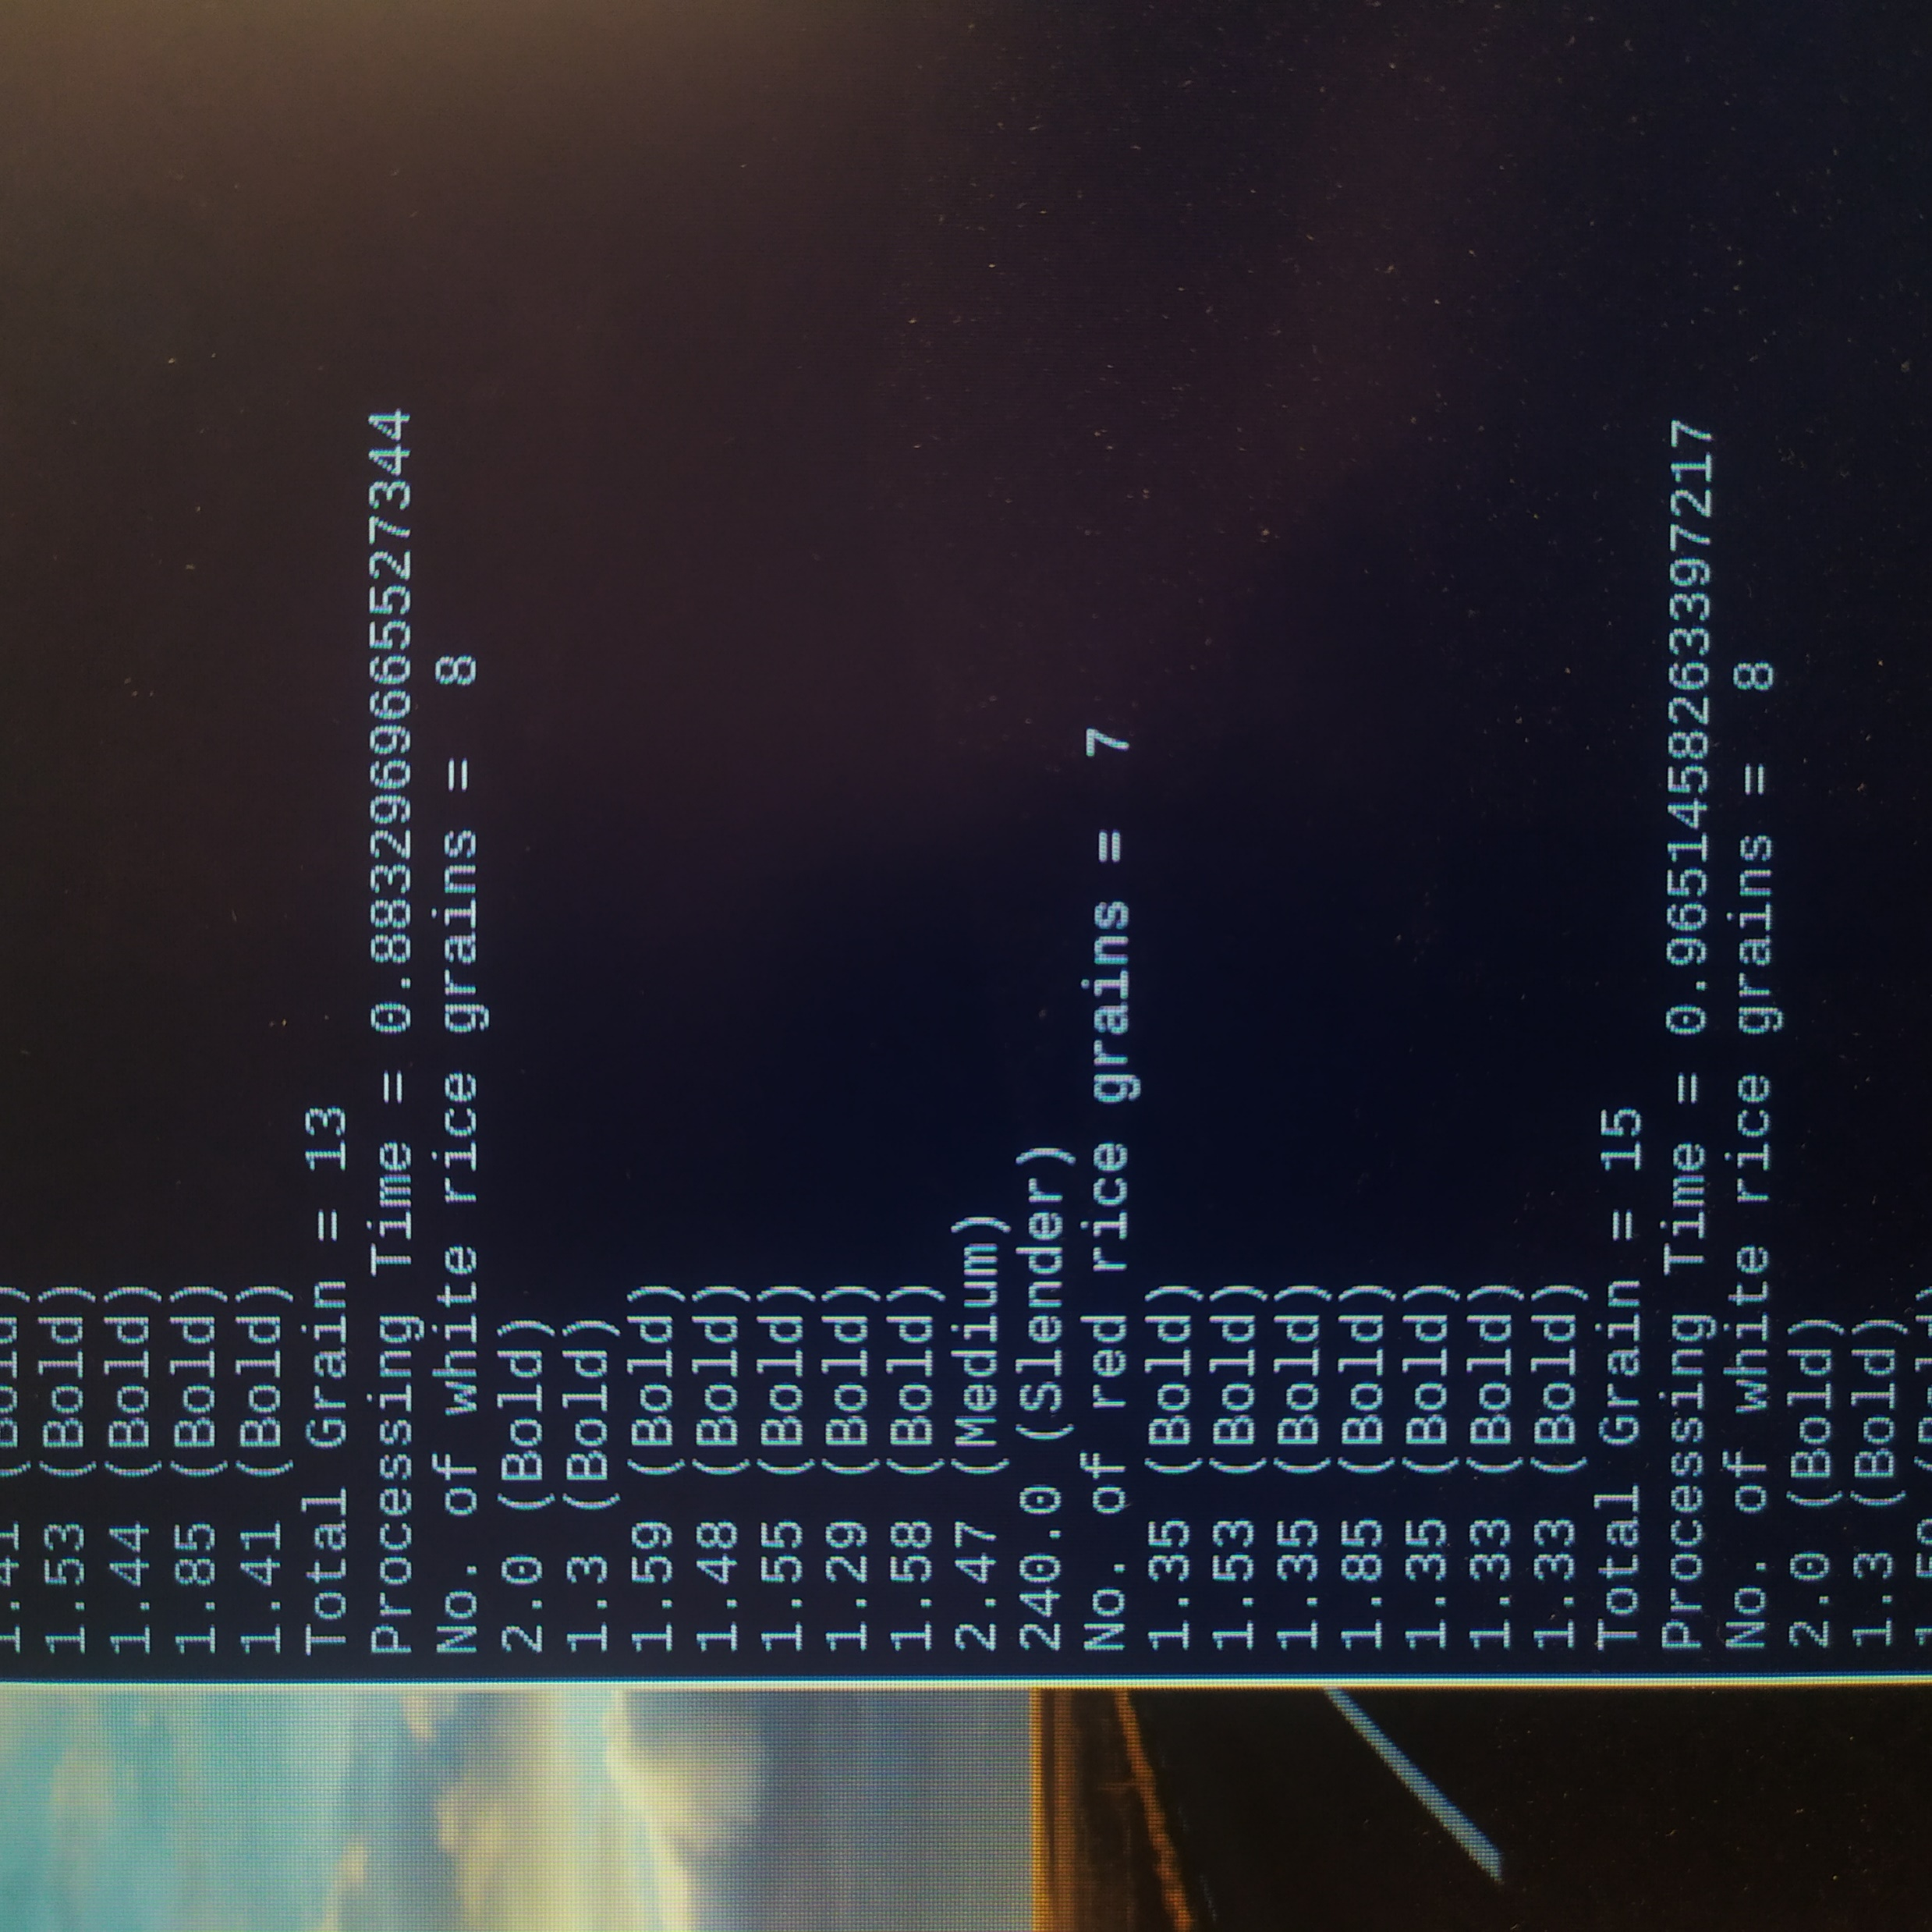
Test Result 1
White grain = 9
Red grain = 7
Total = 16
Test Result 2
White grain = 8
Red grain = 7
Total = 15

Slide 45
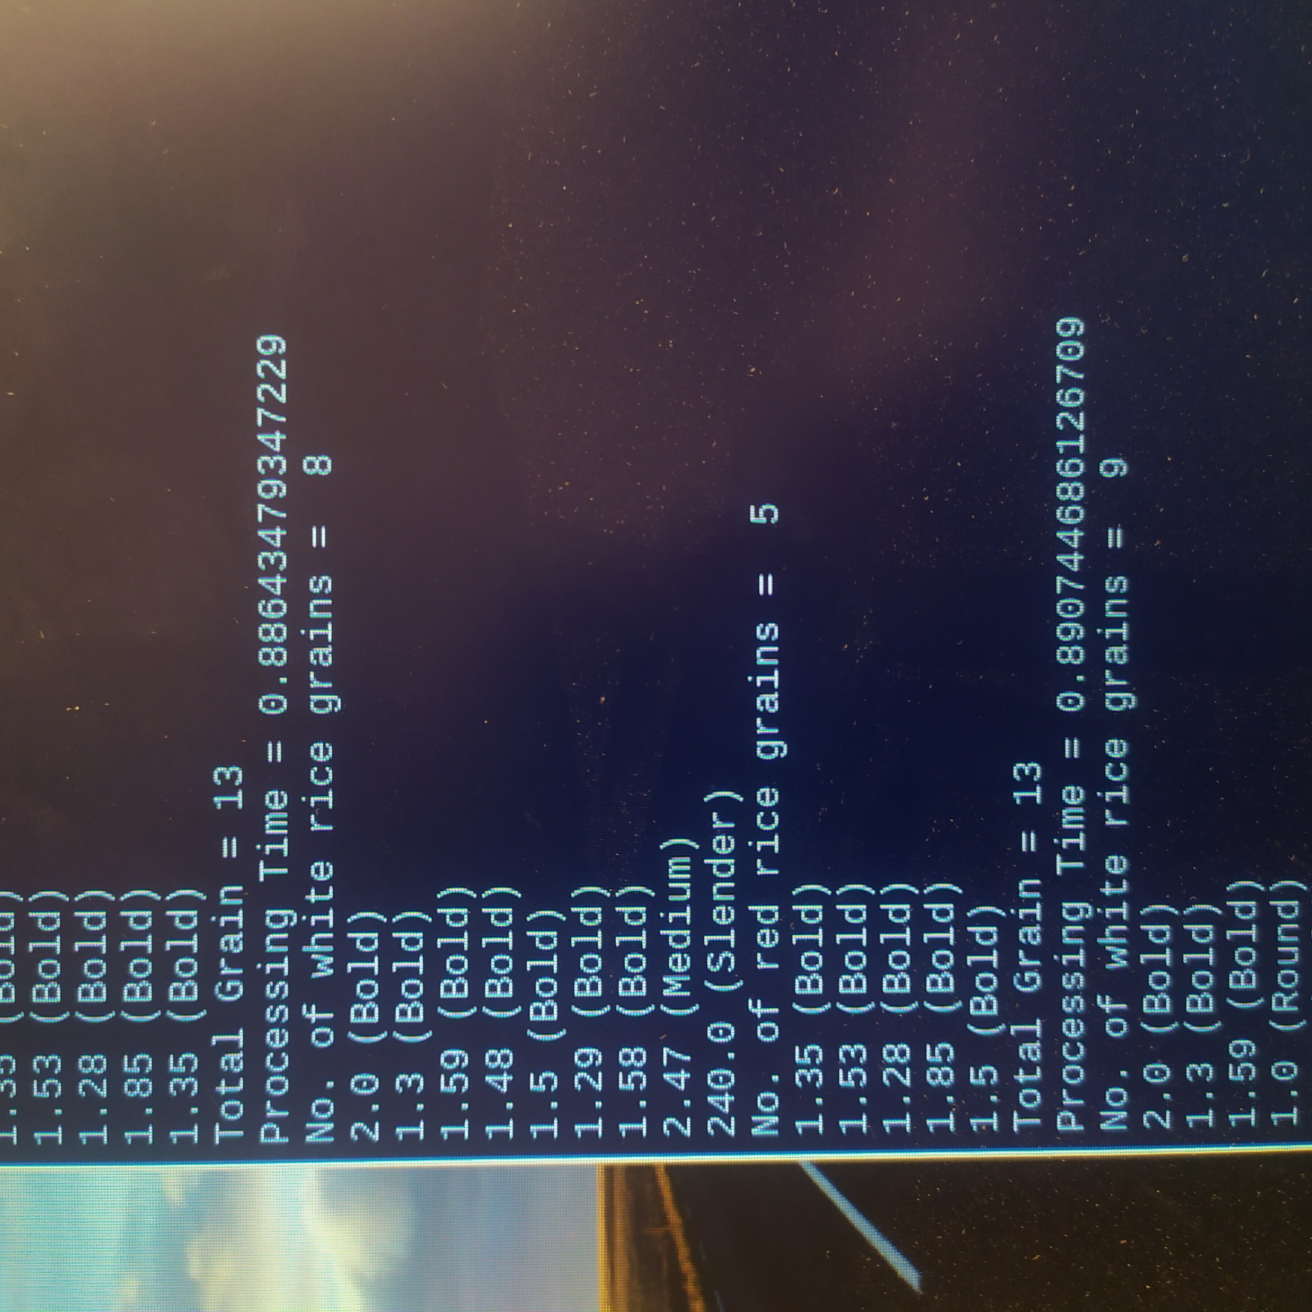
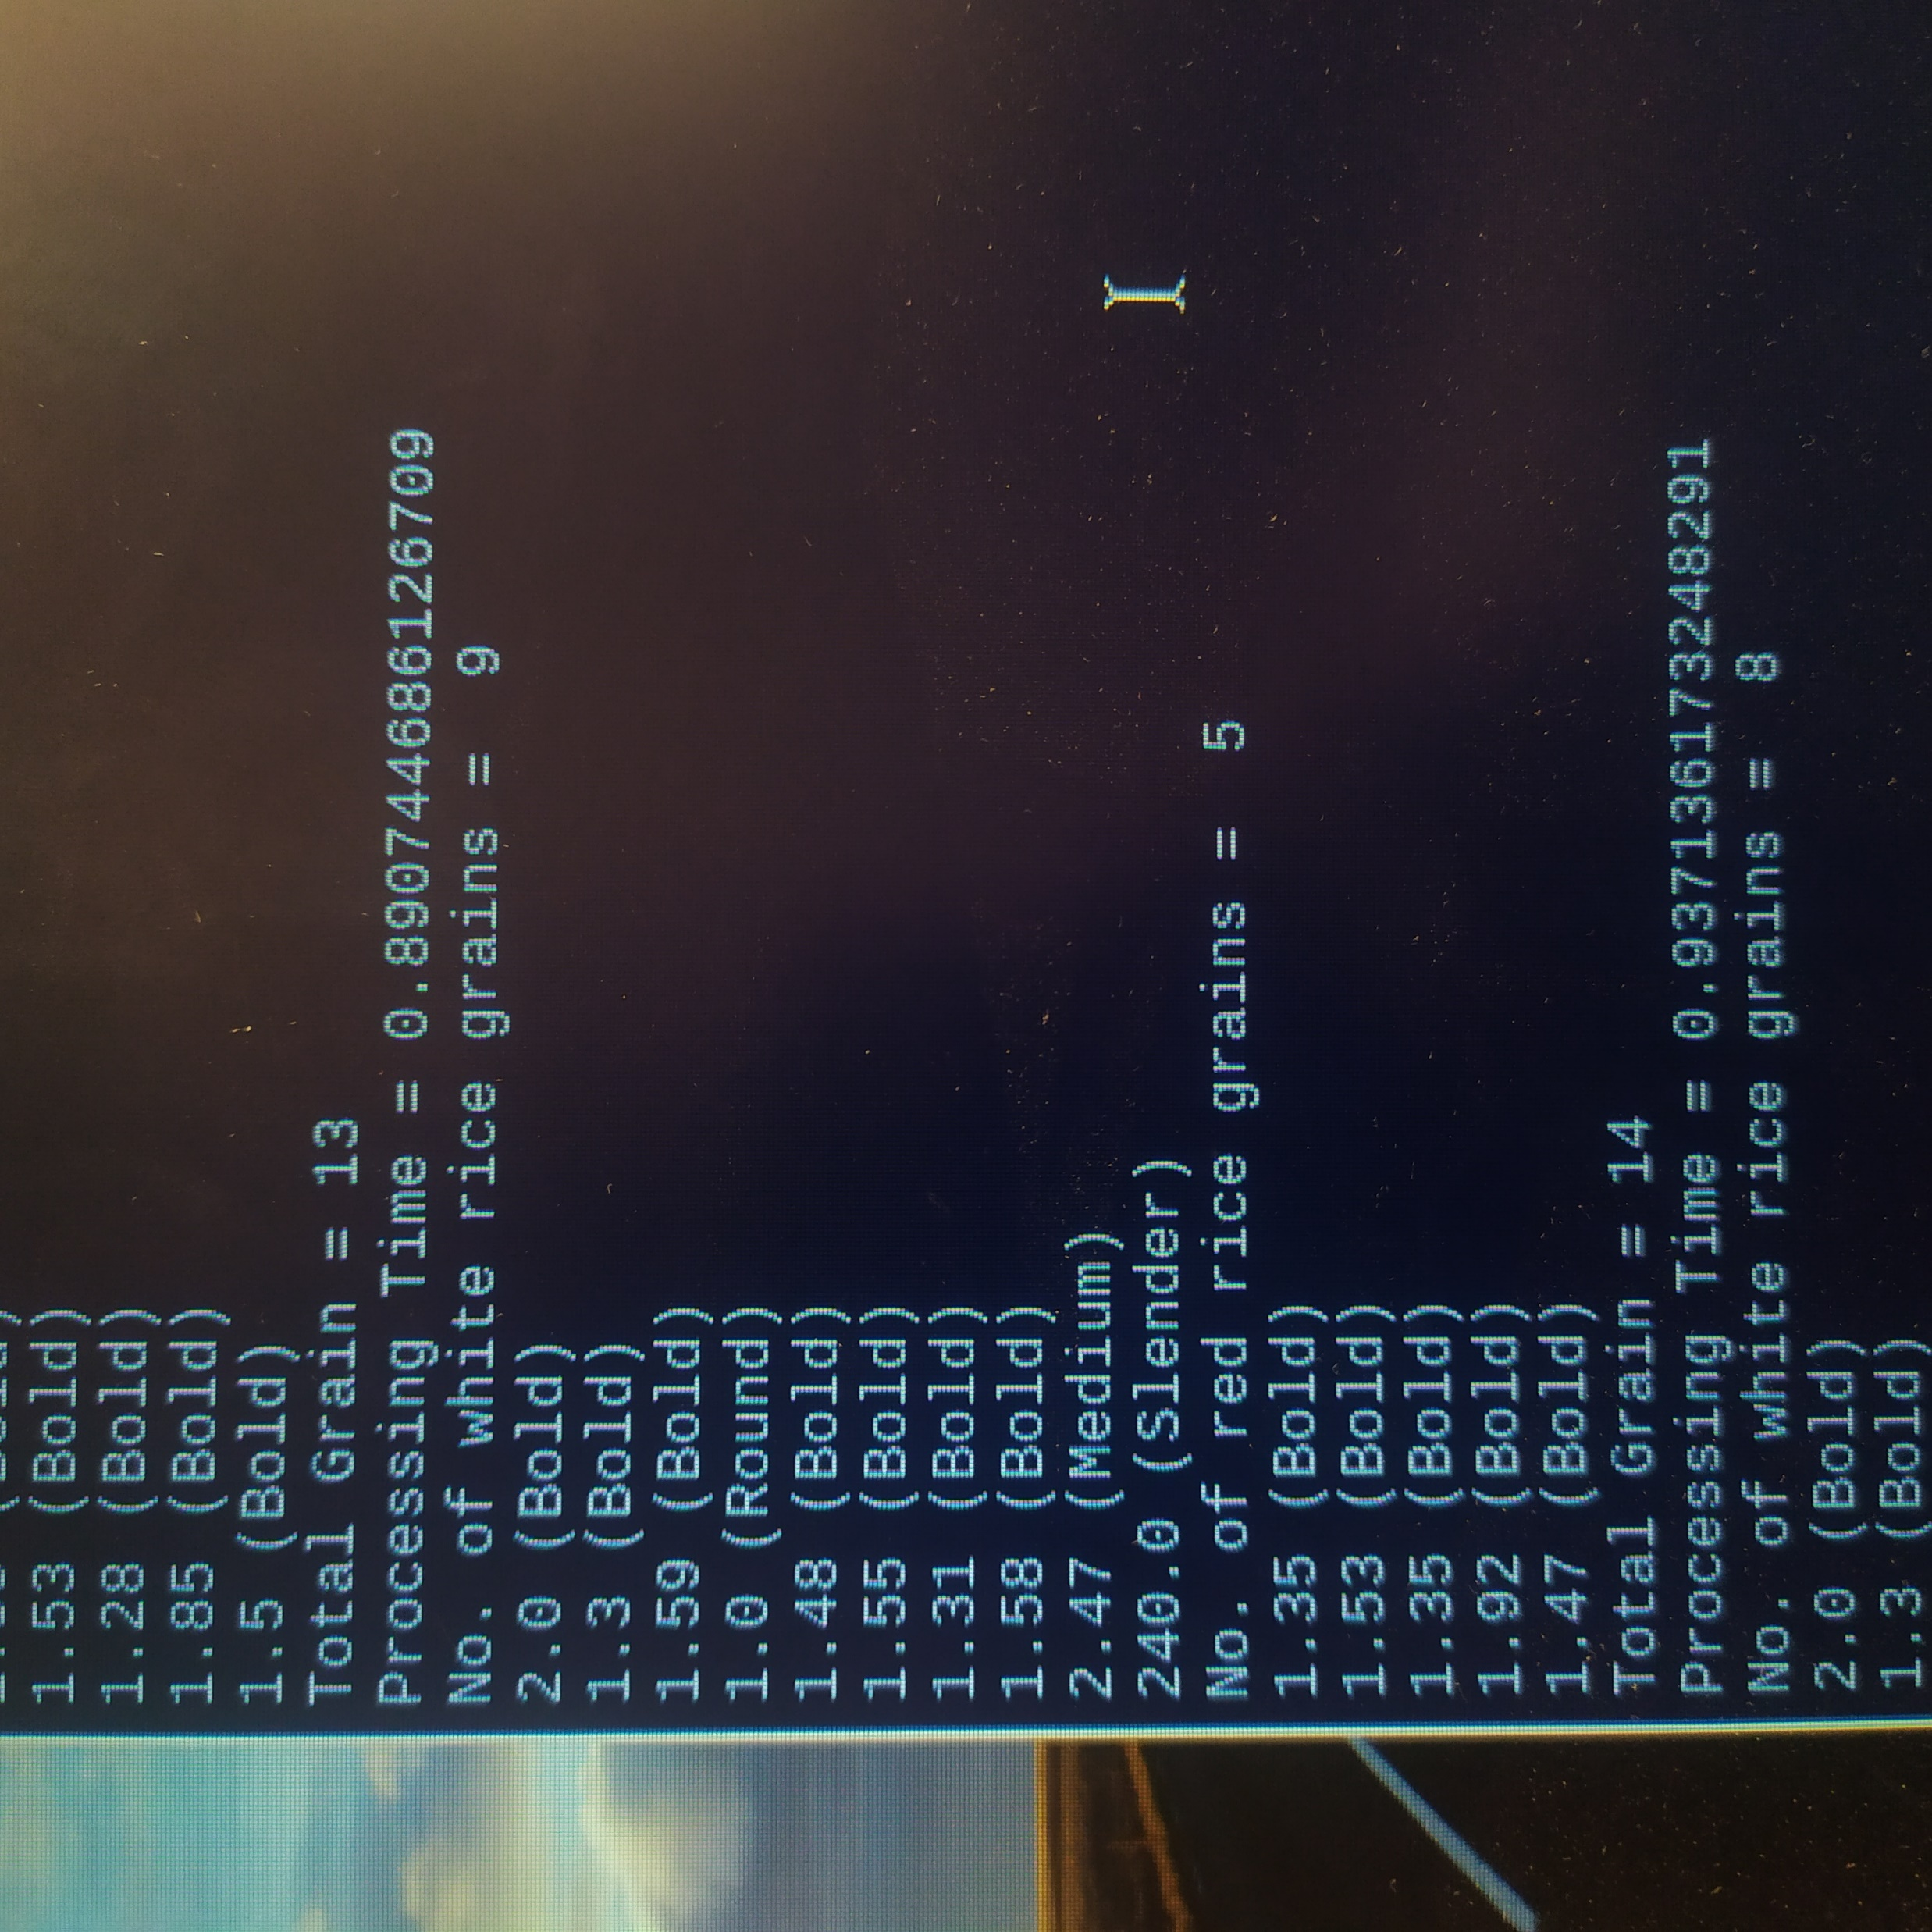
Test Result 3
White grain = 8
Red grain = 5
Total = 13
Test Result 4
White grain = 9
Red grain = 5
Total = 14

Slide 46
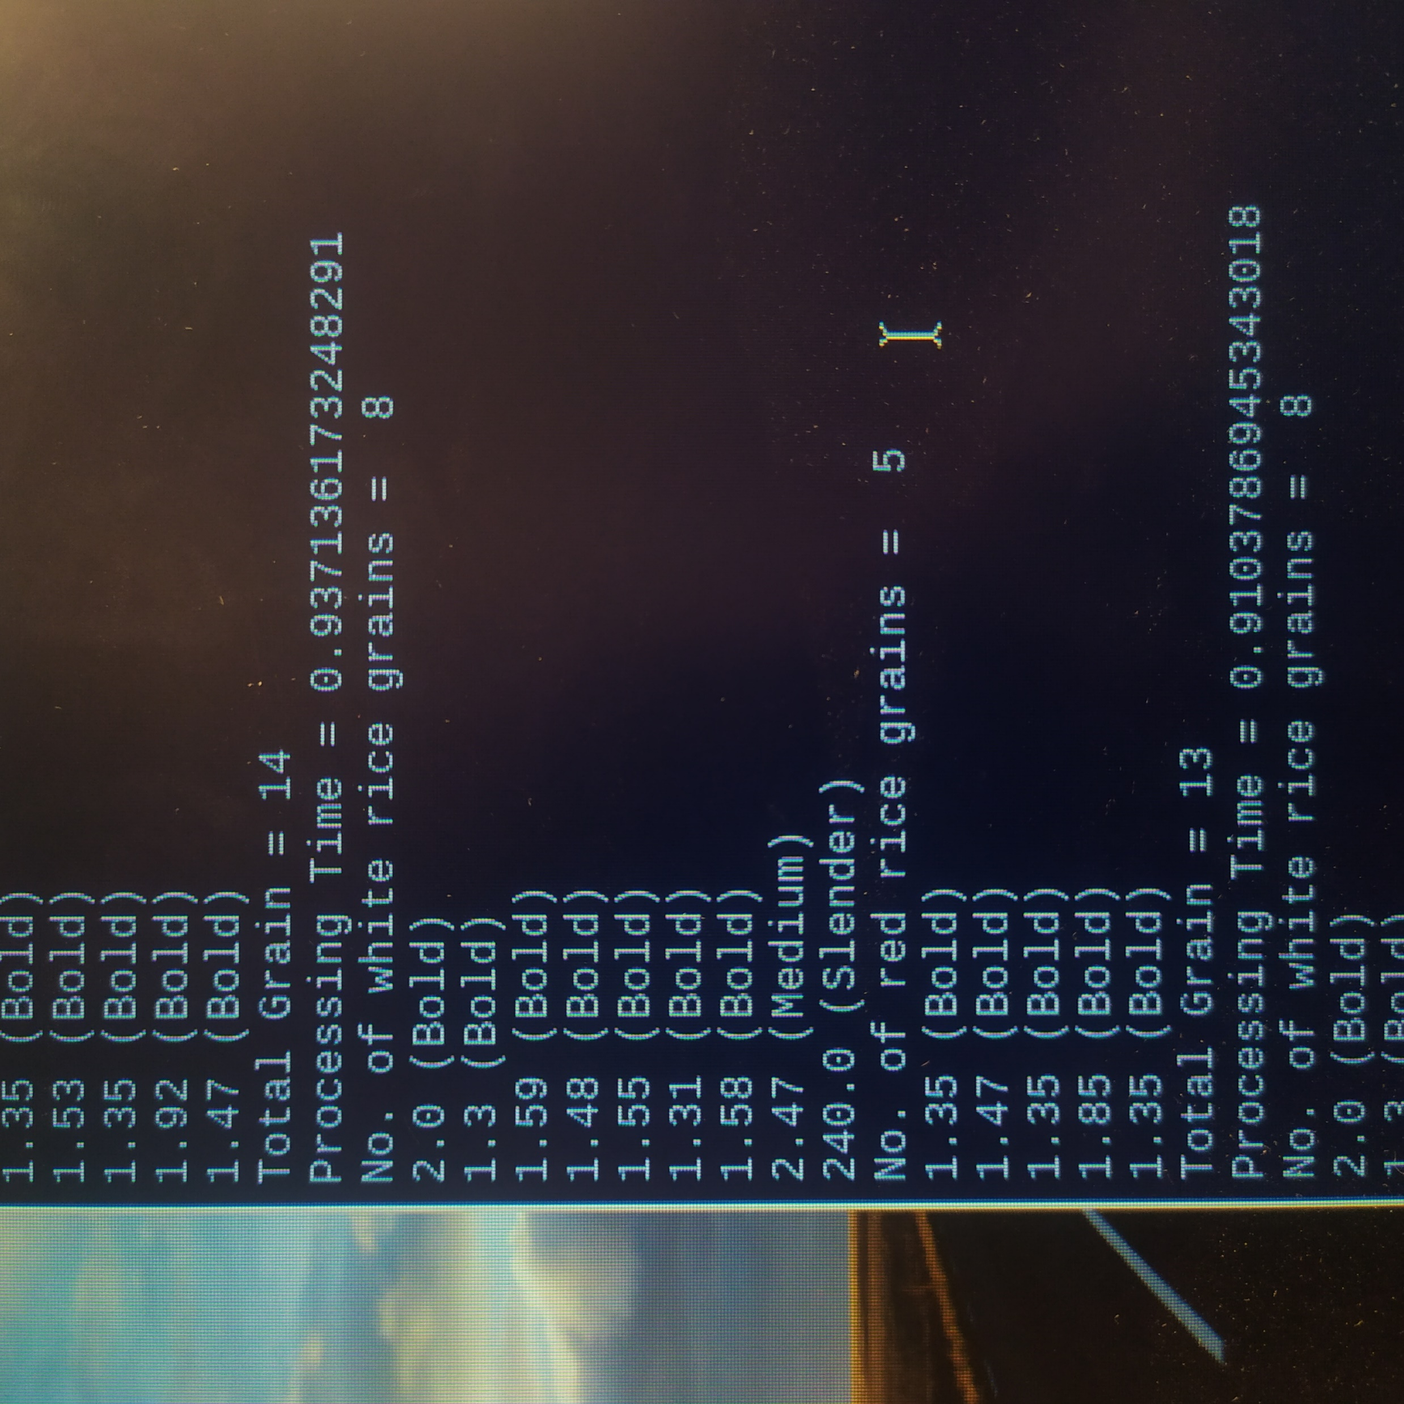
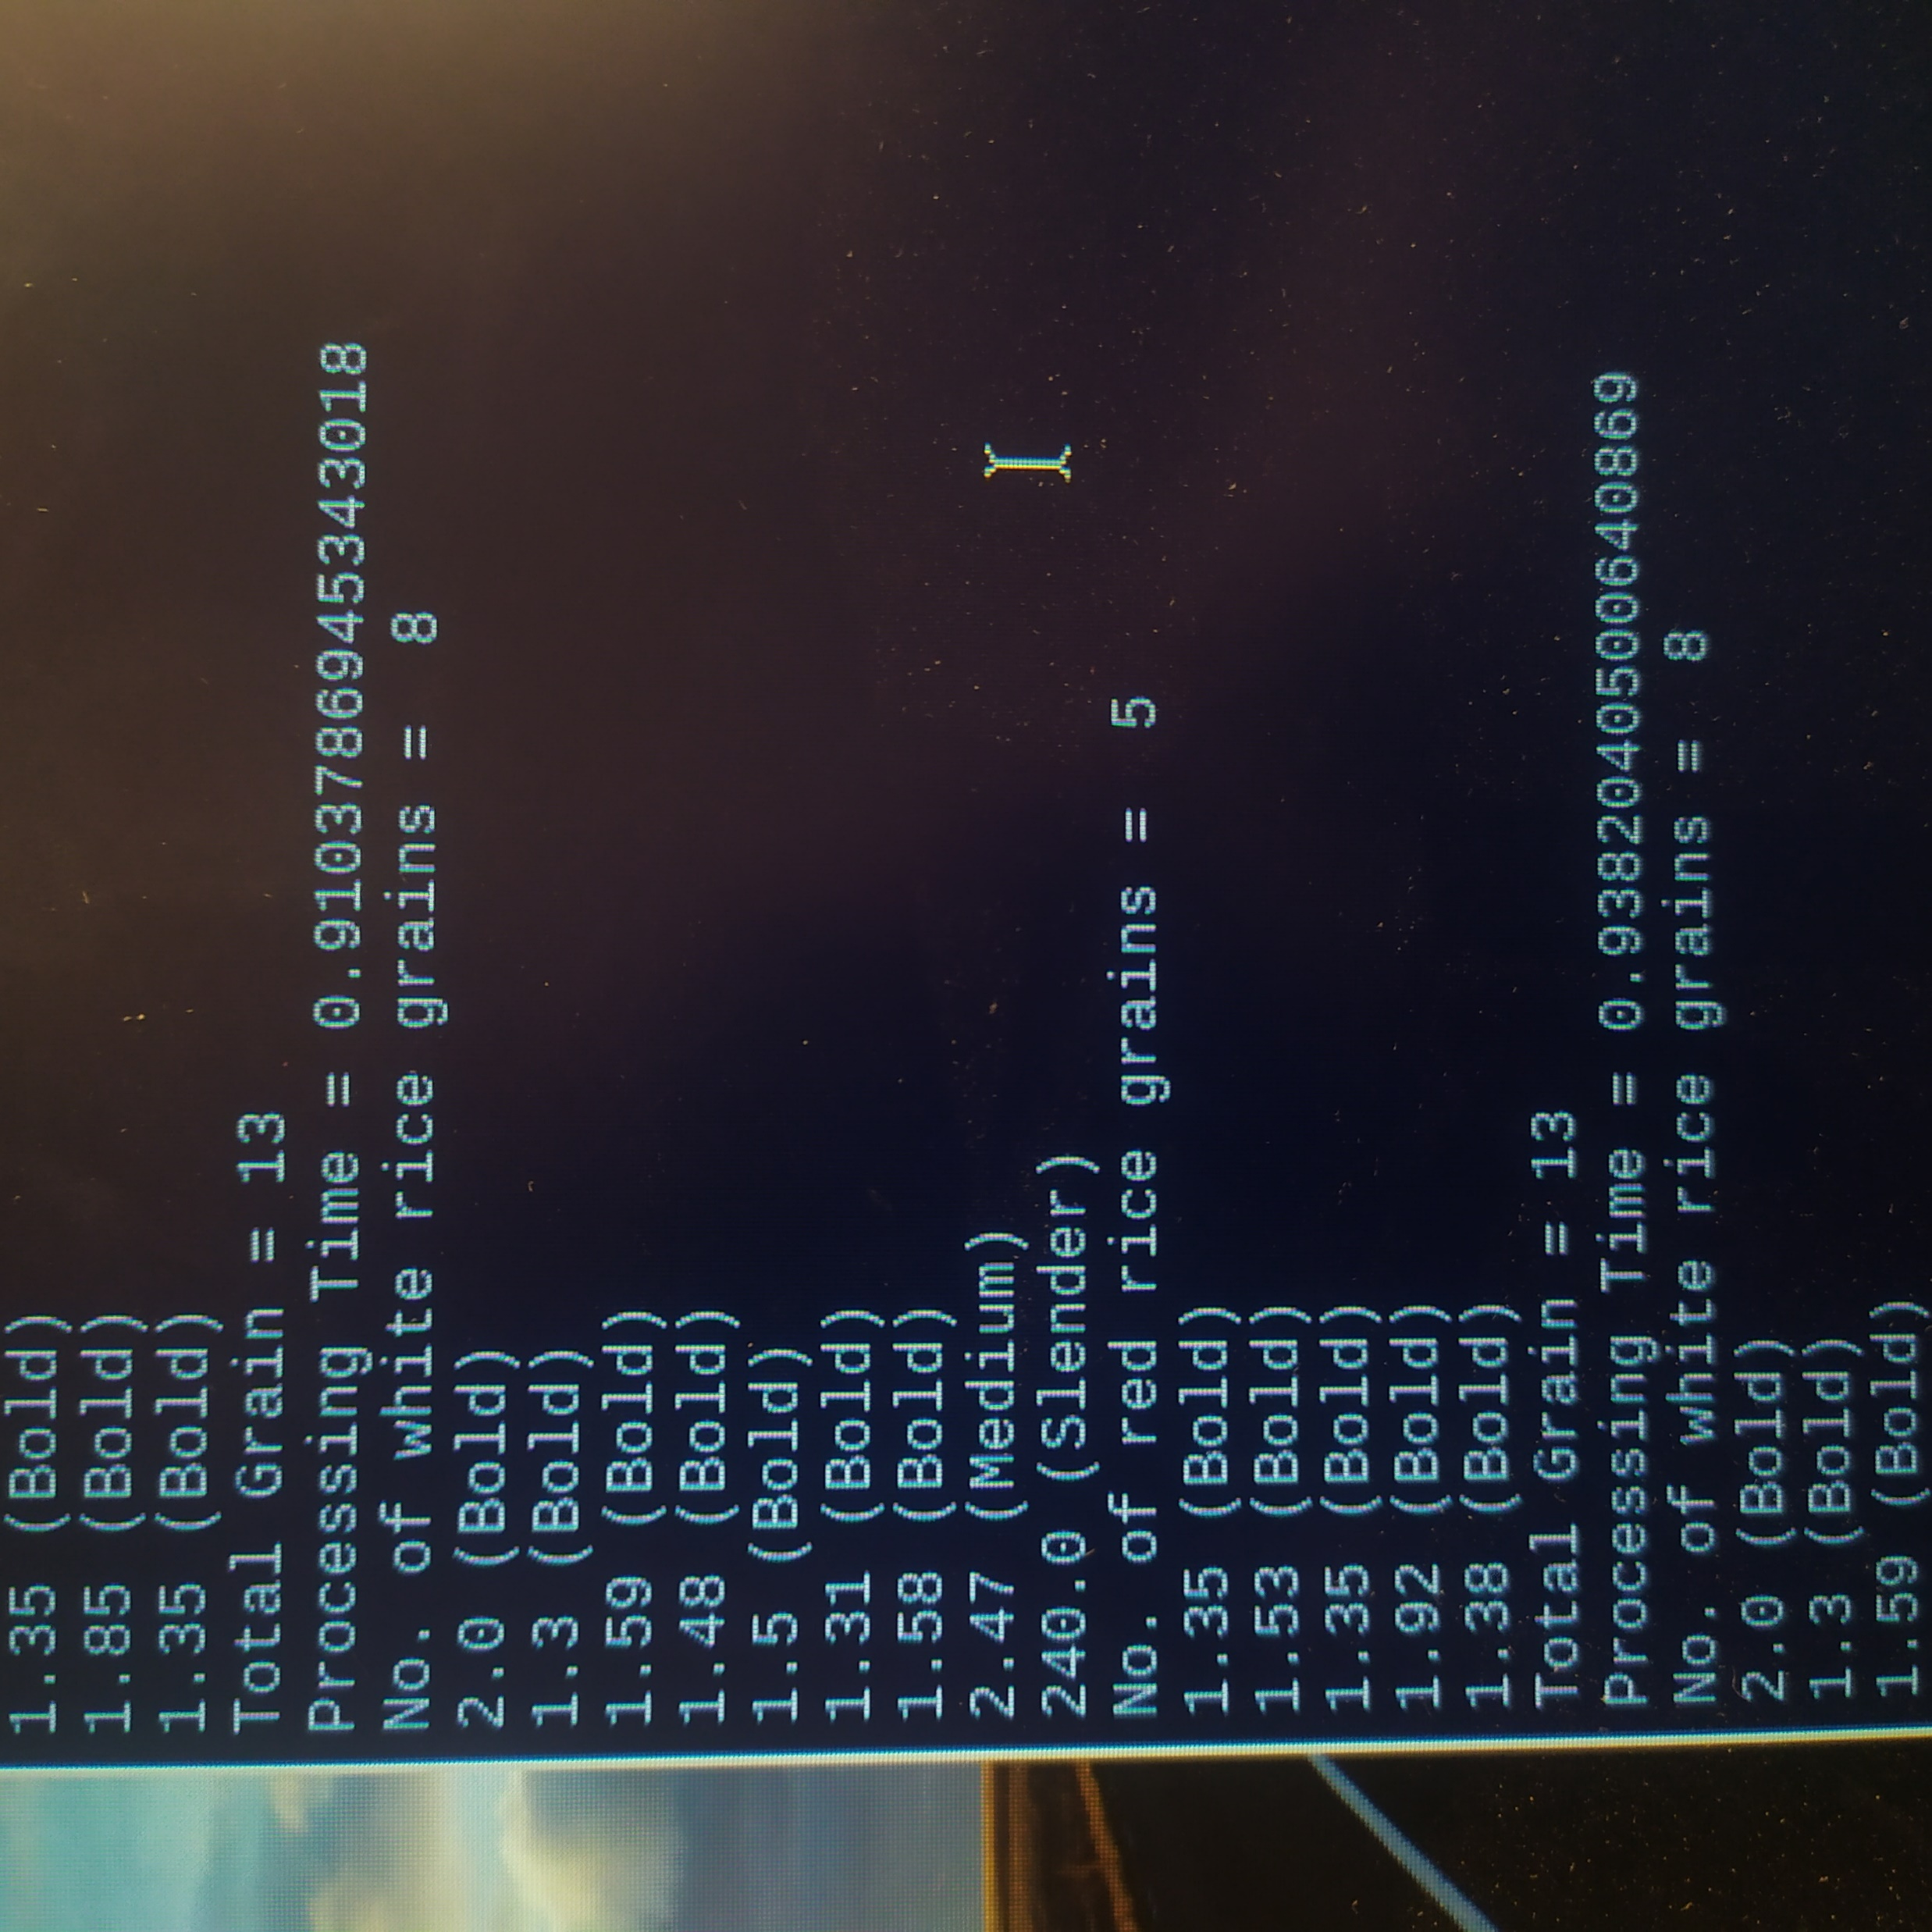
Test Result 5
White grain = 8
Red grain = 5
Total = 13
Test Result 6
White grain = 8
Red grain = 5
Total = 13

Slide 47
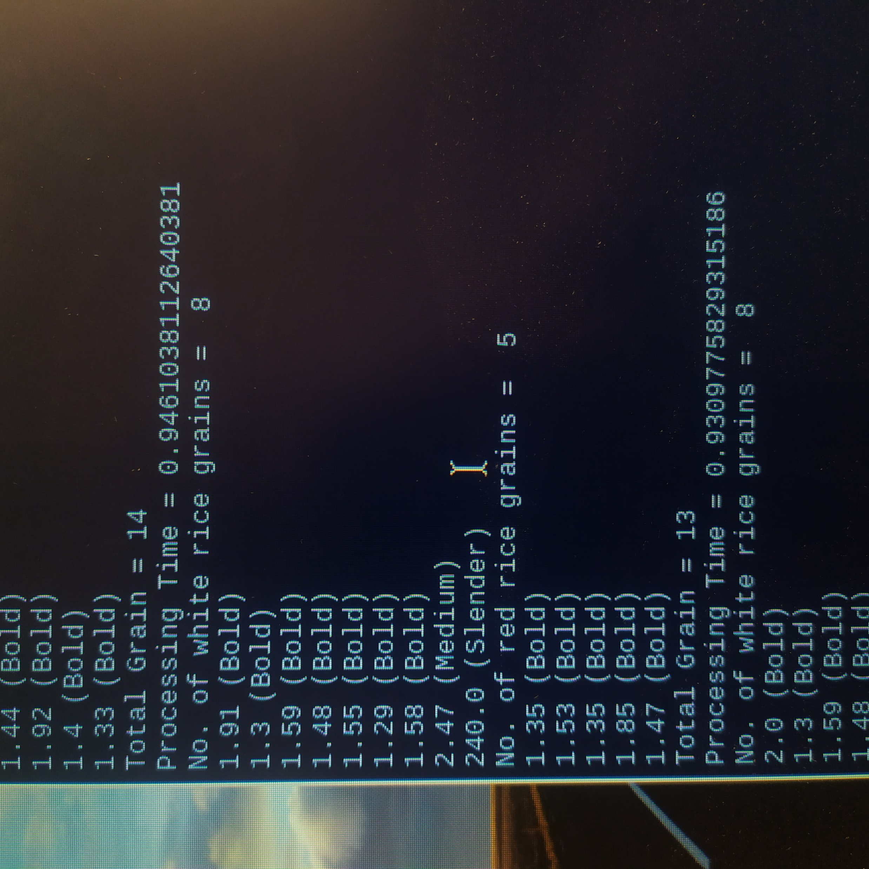
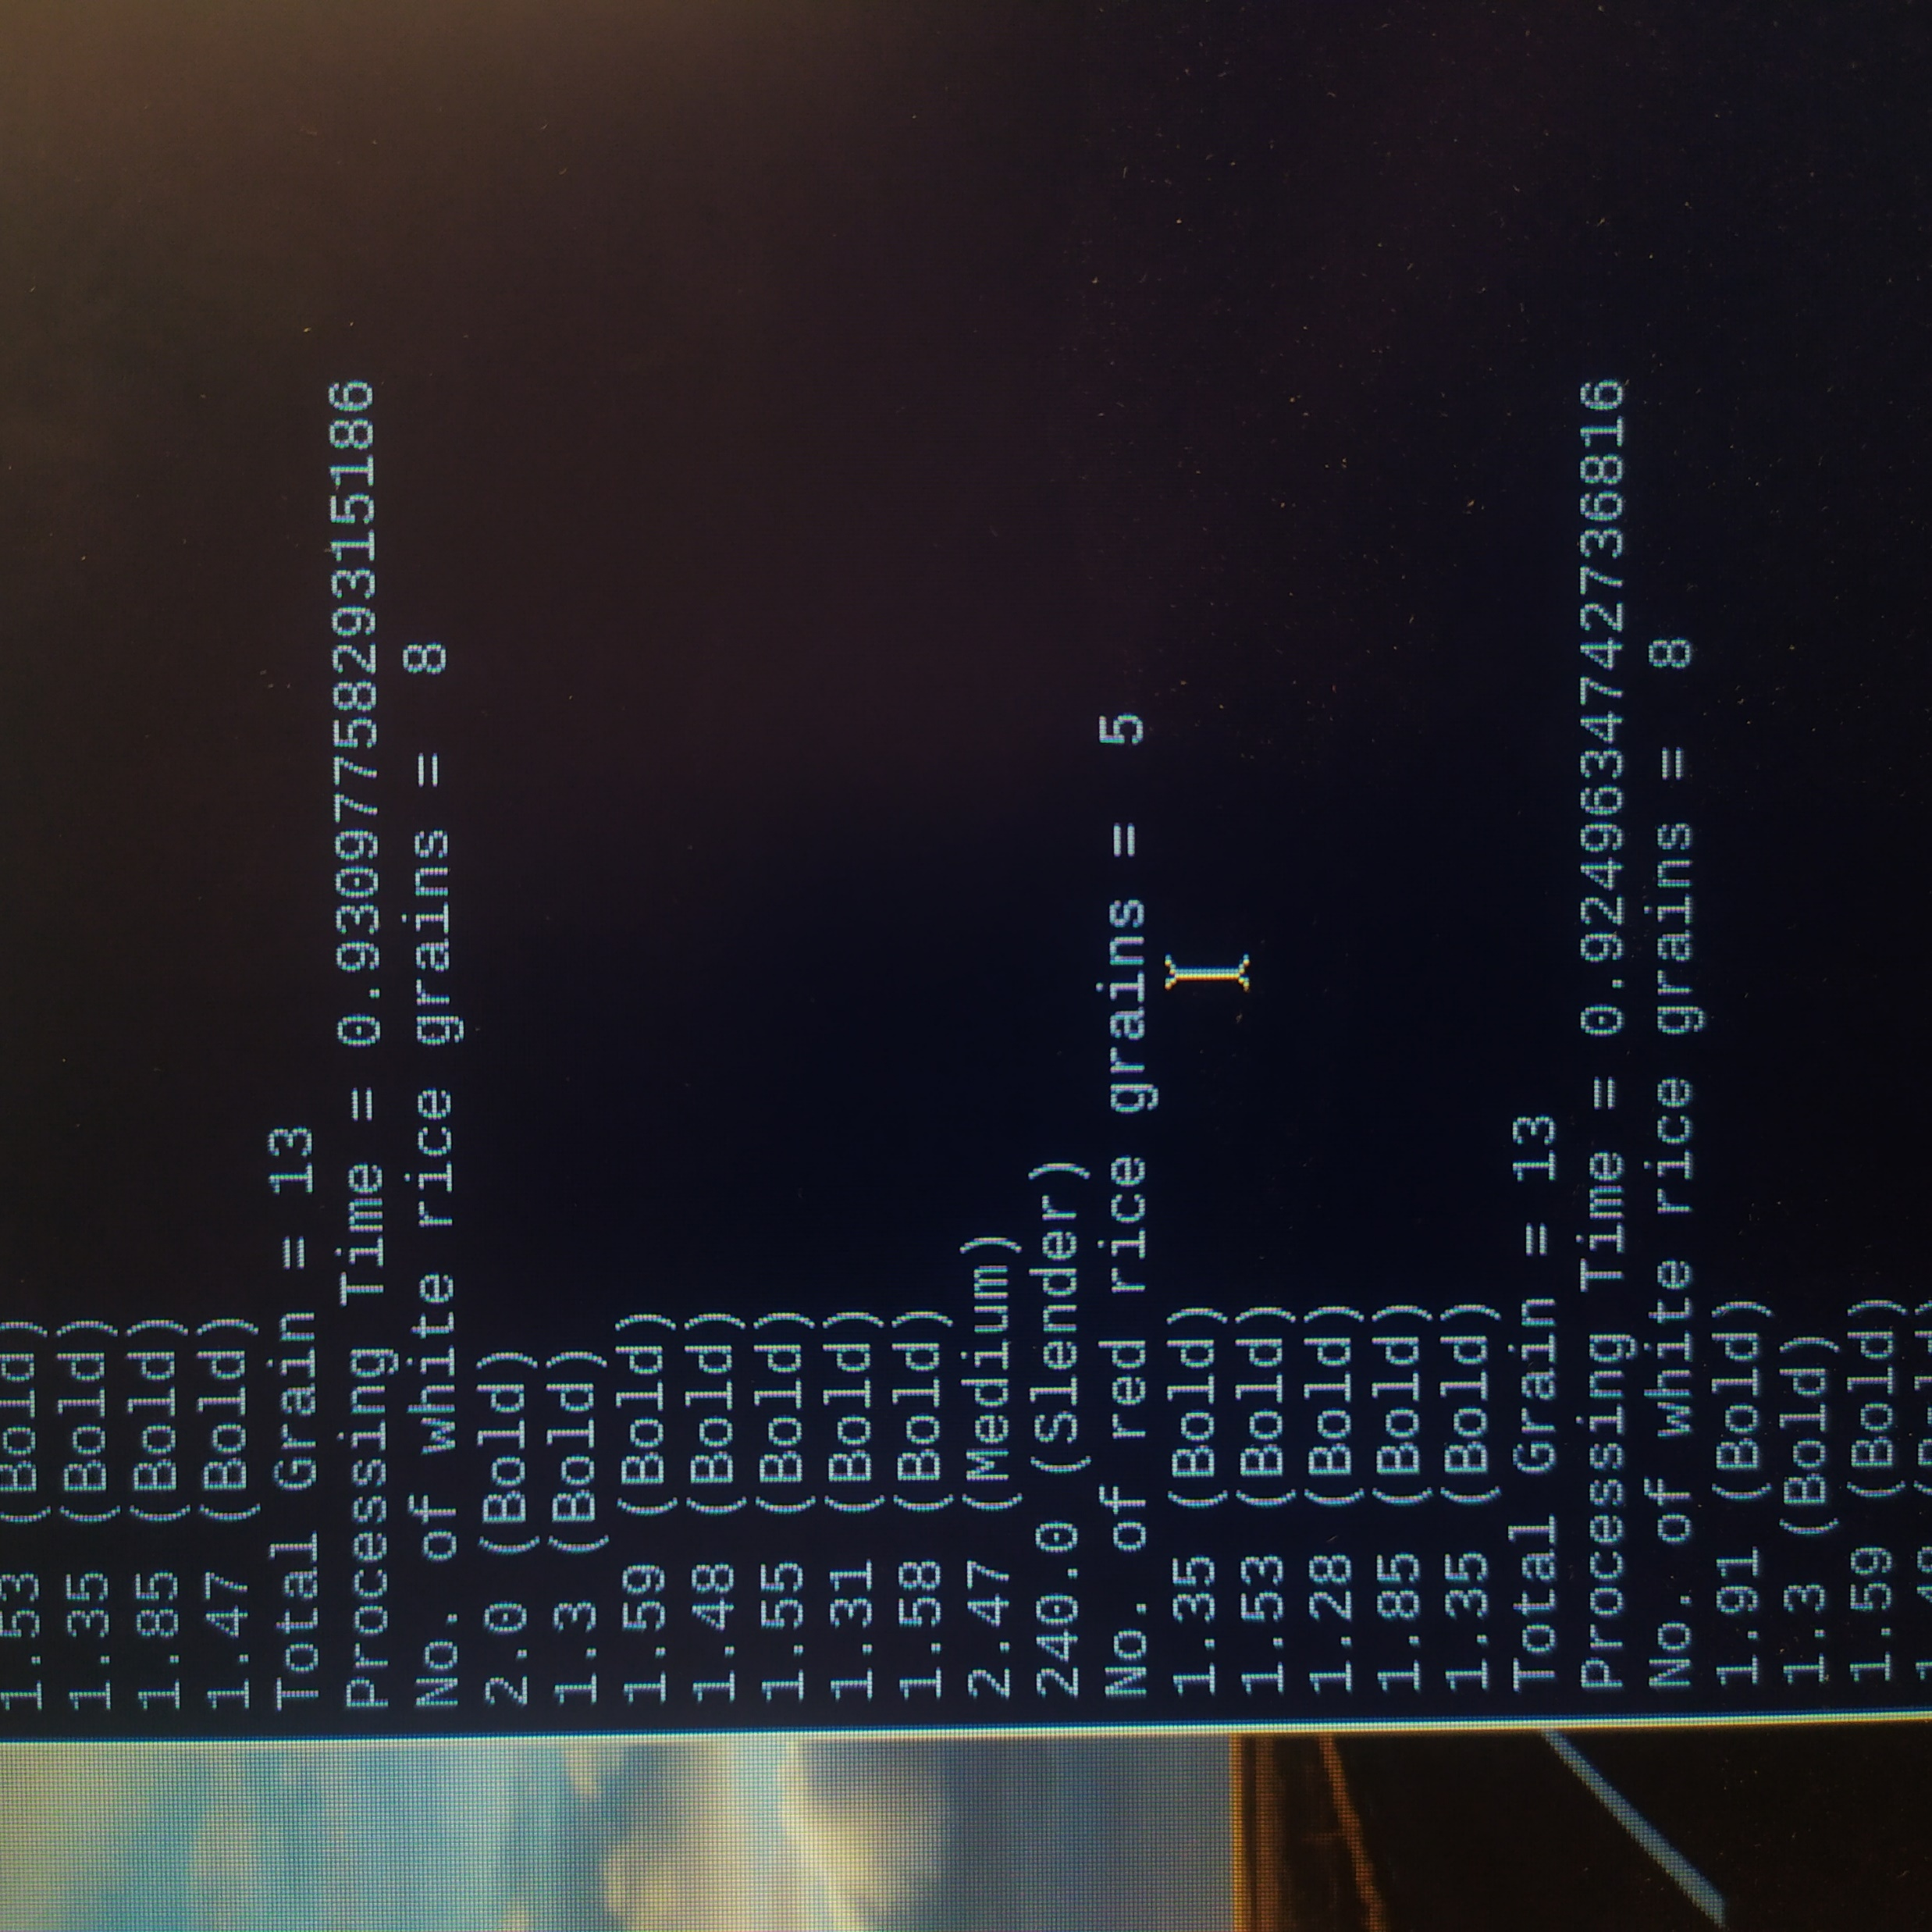
Test Result 7
White grain = 8
Red grain = 5
Total = 13
Test Result 8
White grain = 8
Red grain = 5
Total = 13

Slide 48
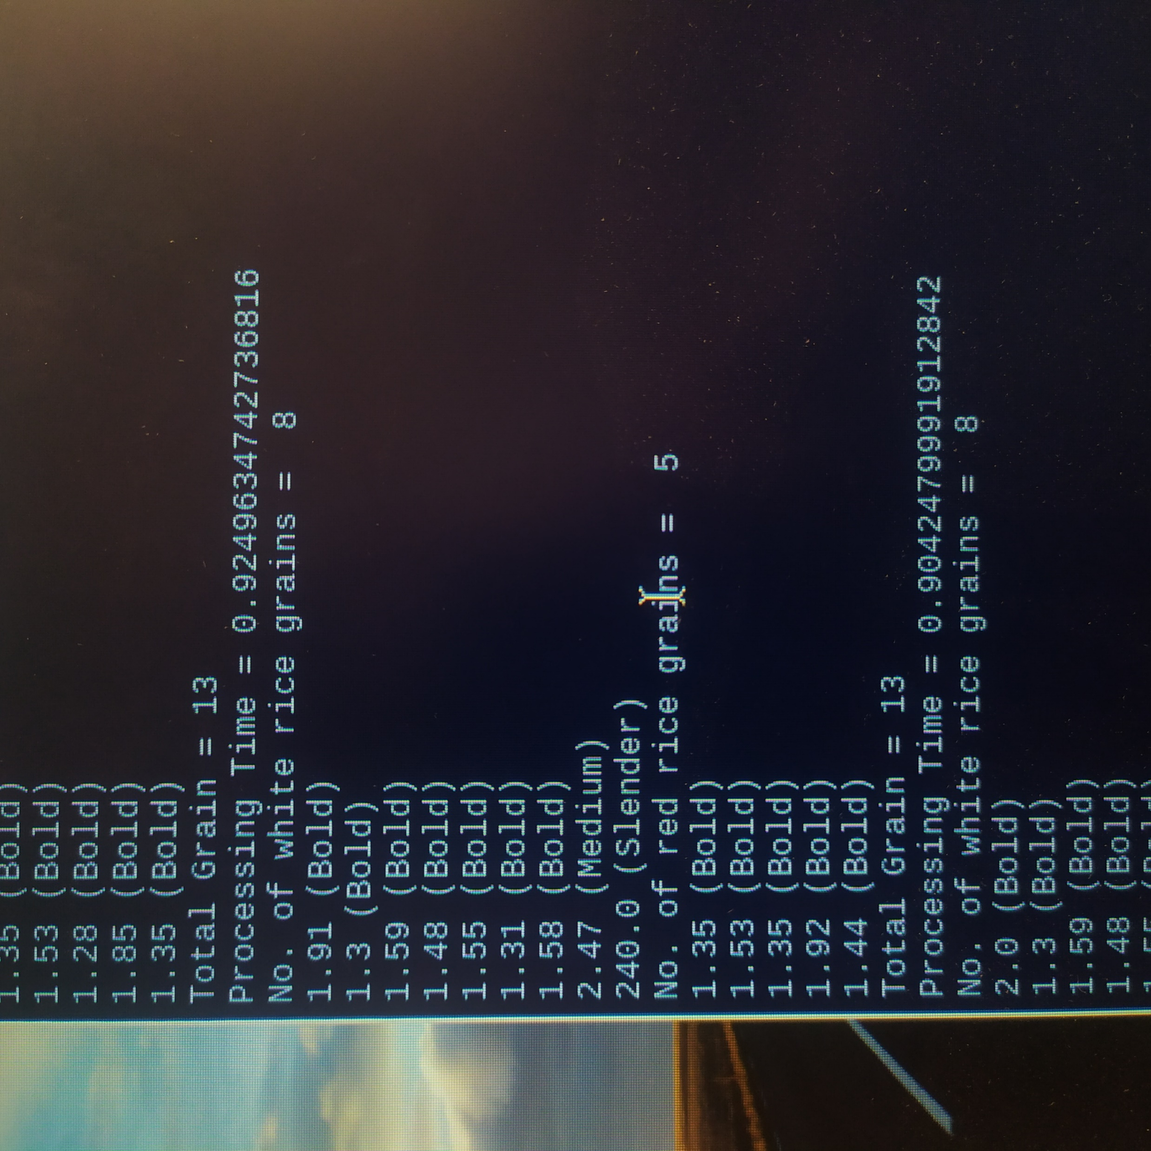
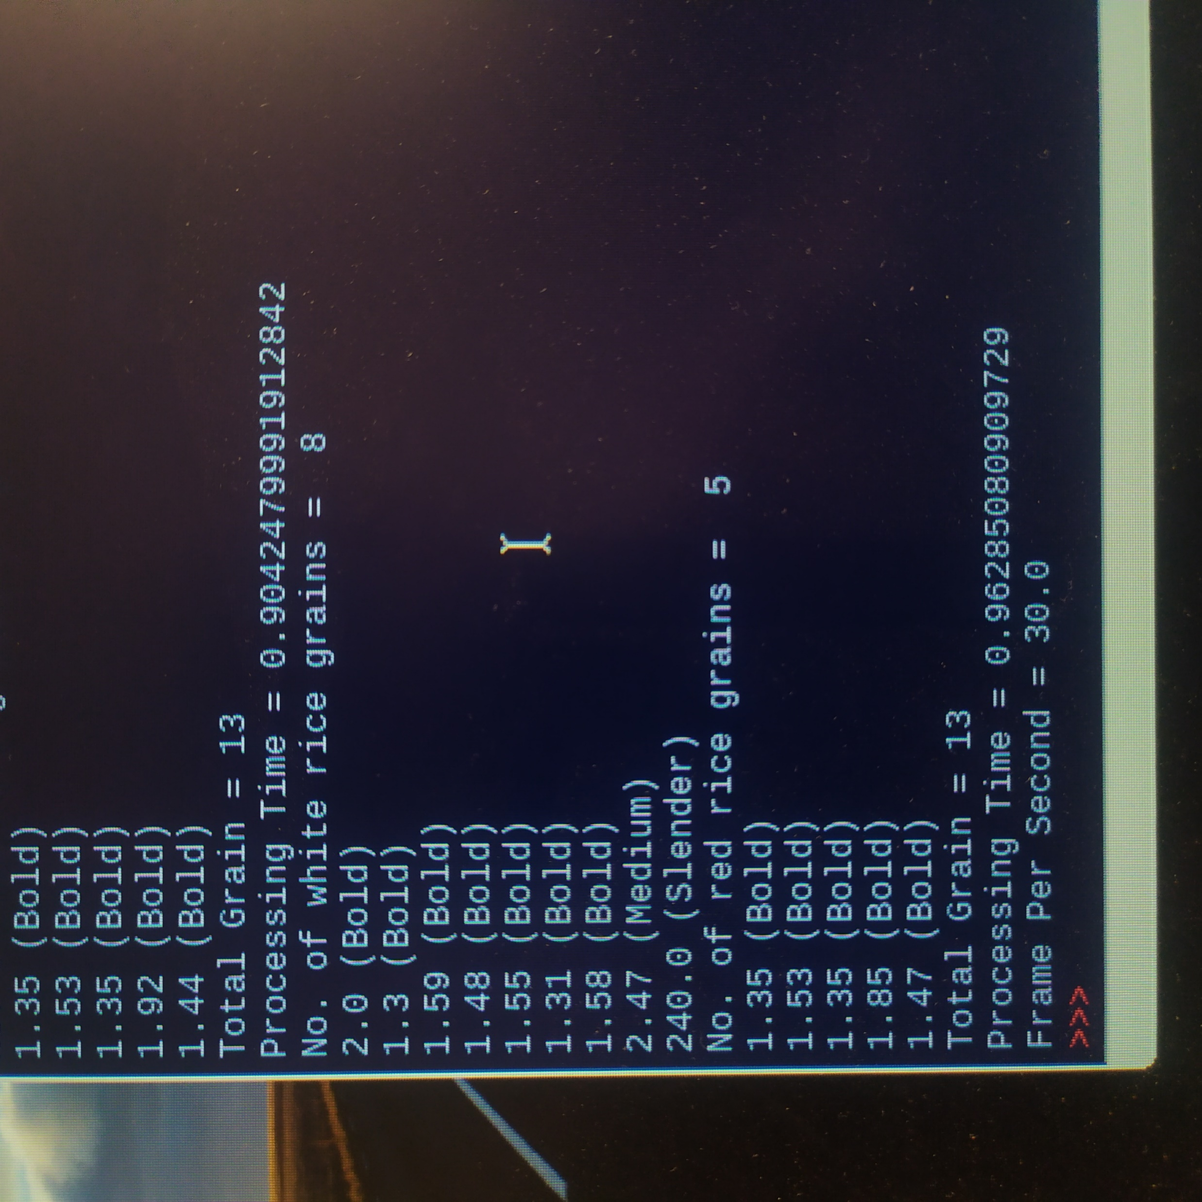
Test Result 9
White grain = 8
Red grain = 5
Total = 13
Test Result 10
White grain = 8
Red grain = 5
Total = 13

Slide 49
System Result Comparison
White Grain | Red Grain | Total Grain
Actual amount = 8 | Actual amount = 5 | Actual amount = 13
System count = 8.2 (last 10 average) | System count = 5.4 (last 10 average) | System count = 13.6 (last 10 average)
Accuracy = 97.5 % | Accuracy = 92 % | Accuracy = 95.4 %
Error = 2.5 % | Error = 8 % | Error = 4.6 %

Slide 50
Further Extension
Implement using classification algorithm such as Neural Network to classify more types of rice grain.
Perform data collection on Websites using IOT.

Slide 51
Conclusion
It can classify the rice grains with greater speed and accuracy than Human Vision Inspection.
This project attempted to highlight the basic problems of rice industry to analyze the quality of rice grains and also highlighted the related work of researchers to eradicate the problem related to quality analysis of rice grains.

Slide 52
References
Fundamentals of Digital Image Processing A Practical Approach with Examples in Matlab by Chris Solomon, Toby Breckon .
Quality Analysis of Indian Basmati Rice Grains Using Digital Image Processing by Sheetal Mahajan1, Sukhvir Kaur2. Sheetal Mahajan et al, / (IJCSIT) International Journal of Computer Science and Information Technologies, Vol. 5 (2) , 2014, 2358-2360.
Neelamegam. P, Abirami. S, Vishnu Priya. K, Rubalya Valantina. S., “Analysis of rice granules using Image Processing and Neural Network”, in IEEE Conference on Information and Communication Technologies (IEEE), ISBN No. 978-1-4673-5758-6, pp. 879-884, 2013.

Slide 53
THANK YOU

